Slide 1

CS 7643: Deep Learning
www.cc.gatech.edu/classes/AY2018/cs7643_fall/
piazza.com/gatech/fall2017/cs7643 Canvas: gatech.instructure.com/courses/772
Dhruv Batra
School of Interactive Computing Georgia Tech

Slide 2
Outline
What is Deep Learning, the field, about?
Highlight of some recent projects from my lab
What is this class about?
What to expect?
Logistics
FAQ

Slide 3
What is this class about?
Some of the most exciting developments in
Machine Learning, Vision, NLP, Speech, Robotics & AI in general
in the last 5 years!

Slide 4
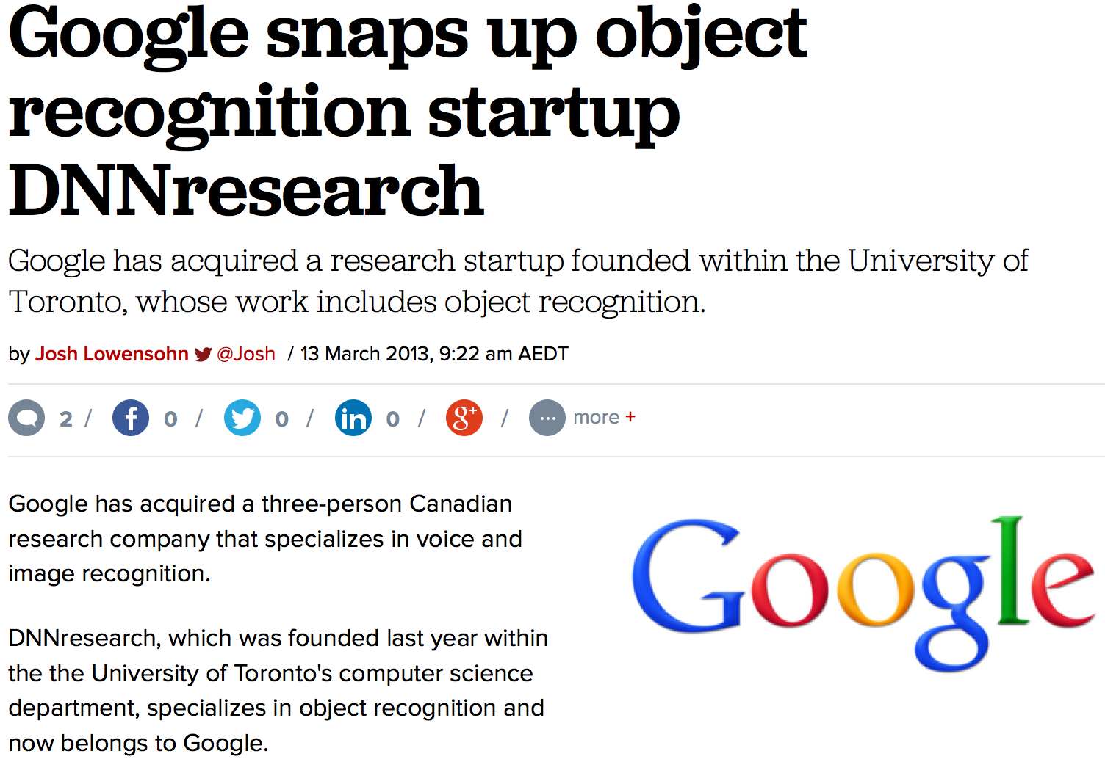
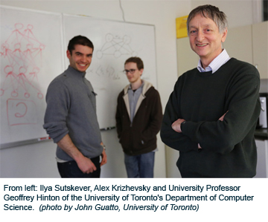
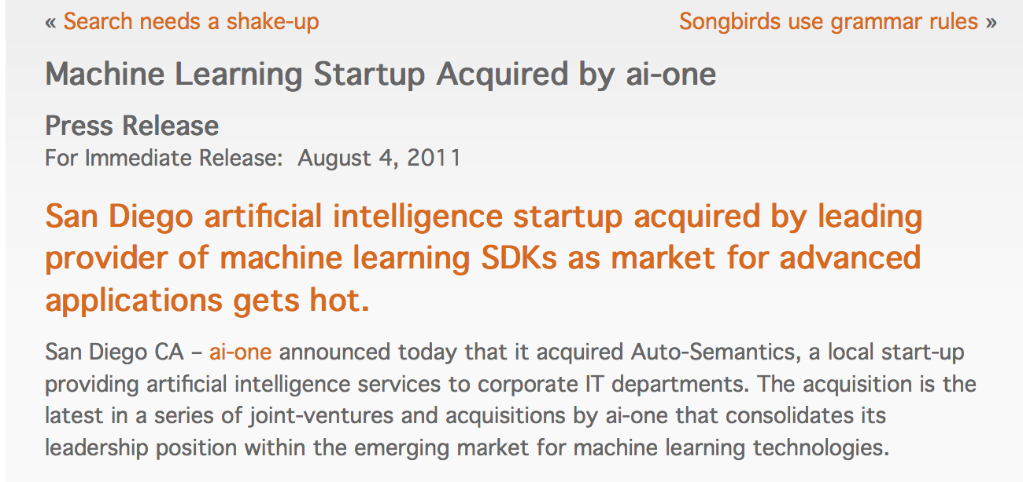
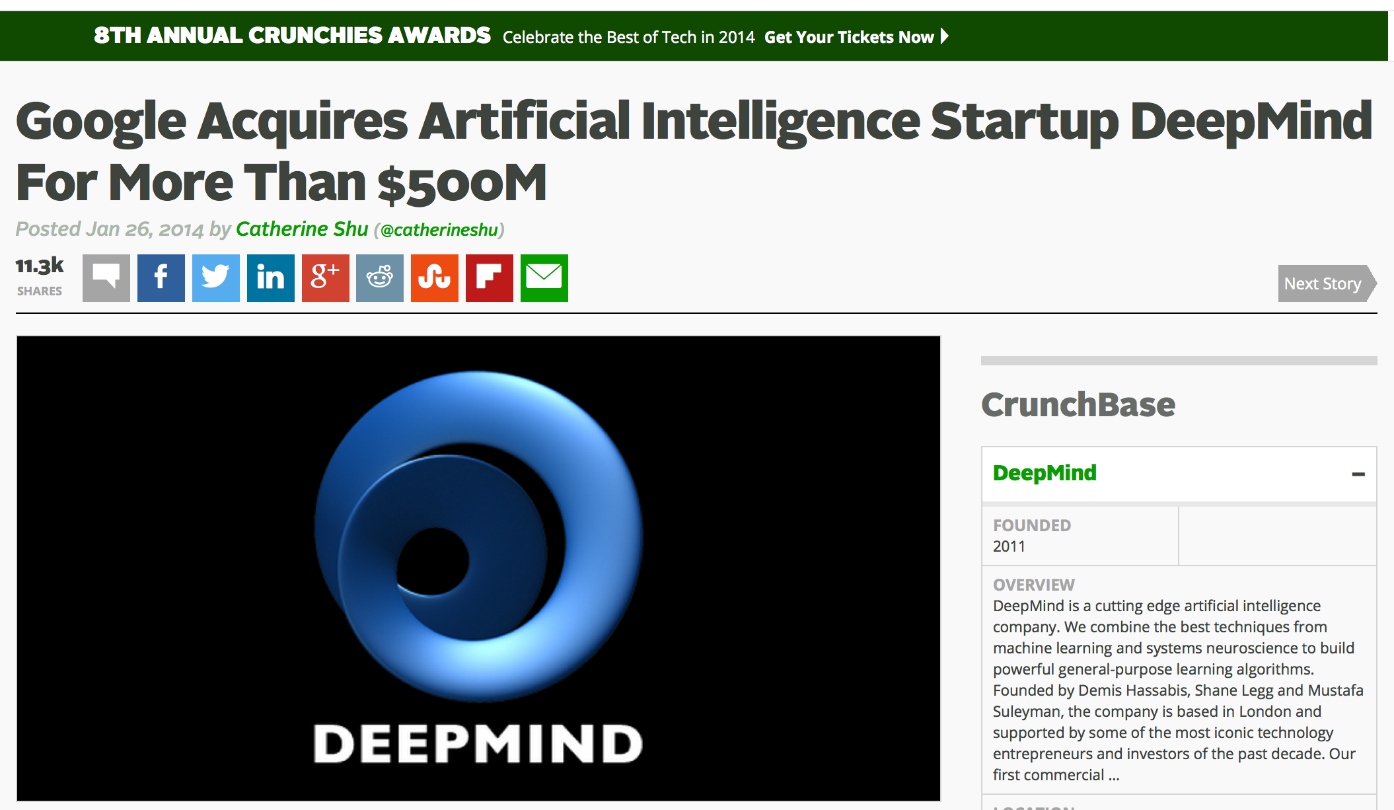
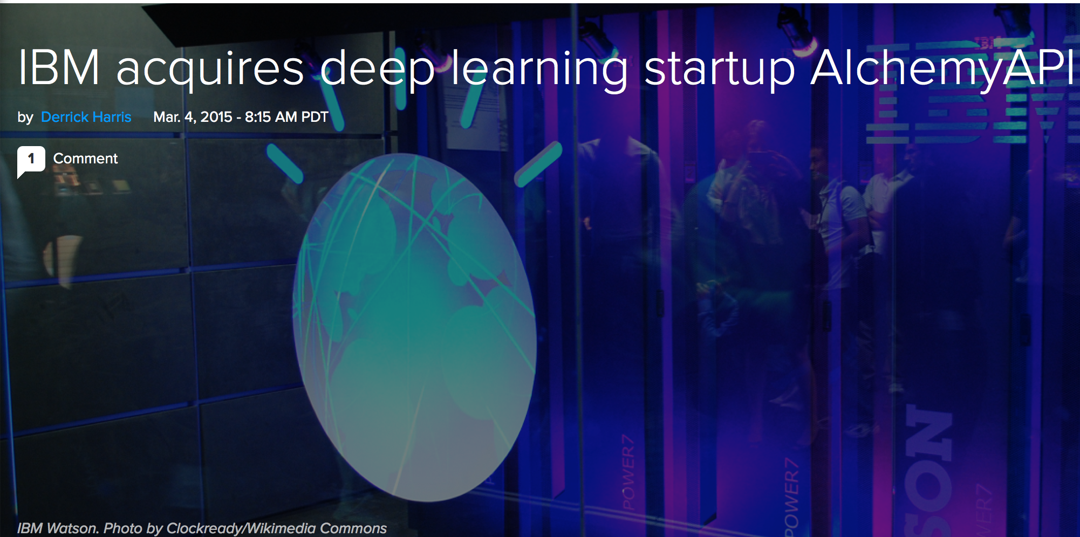
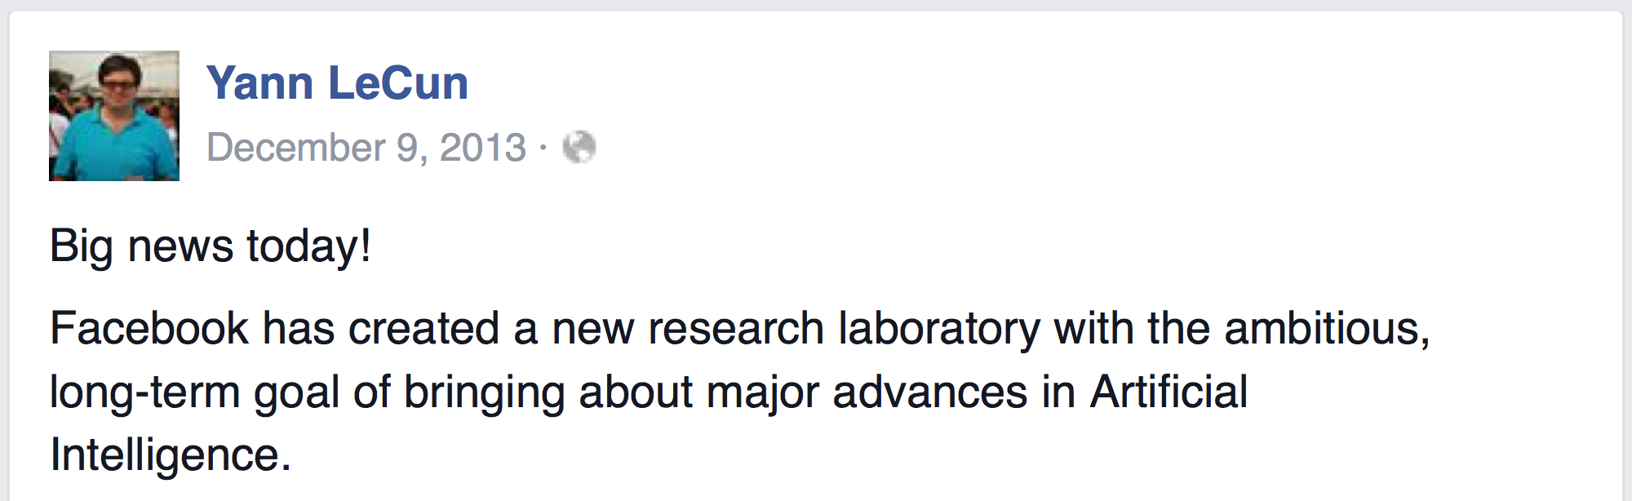
Acquisitions

Slide 5
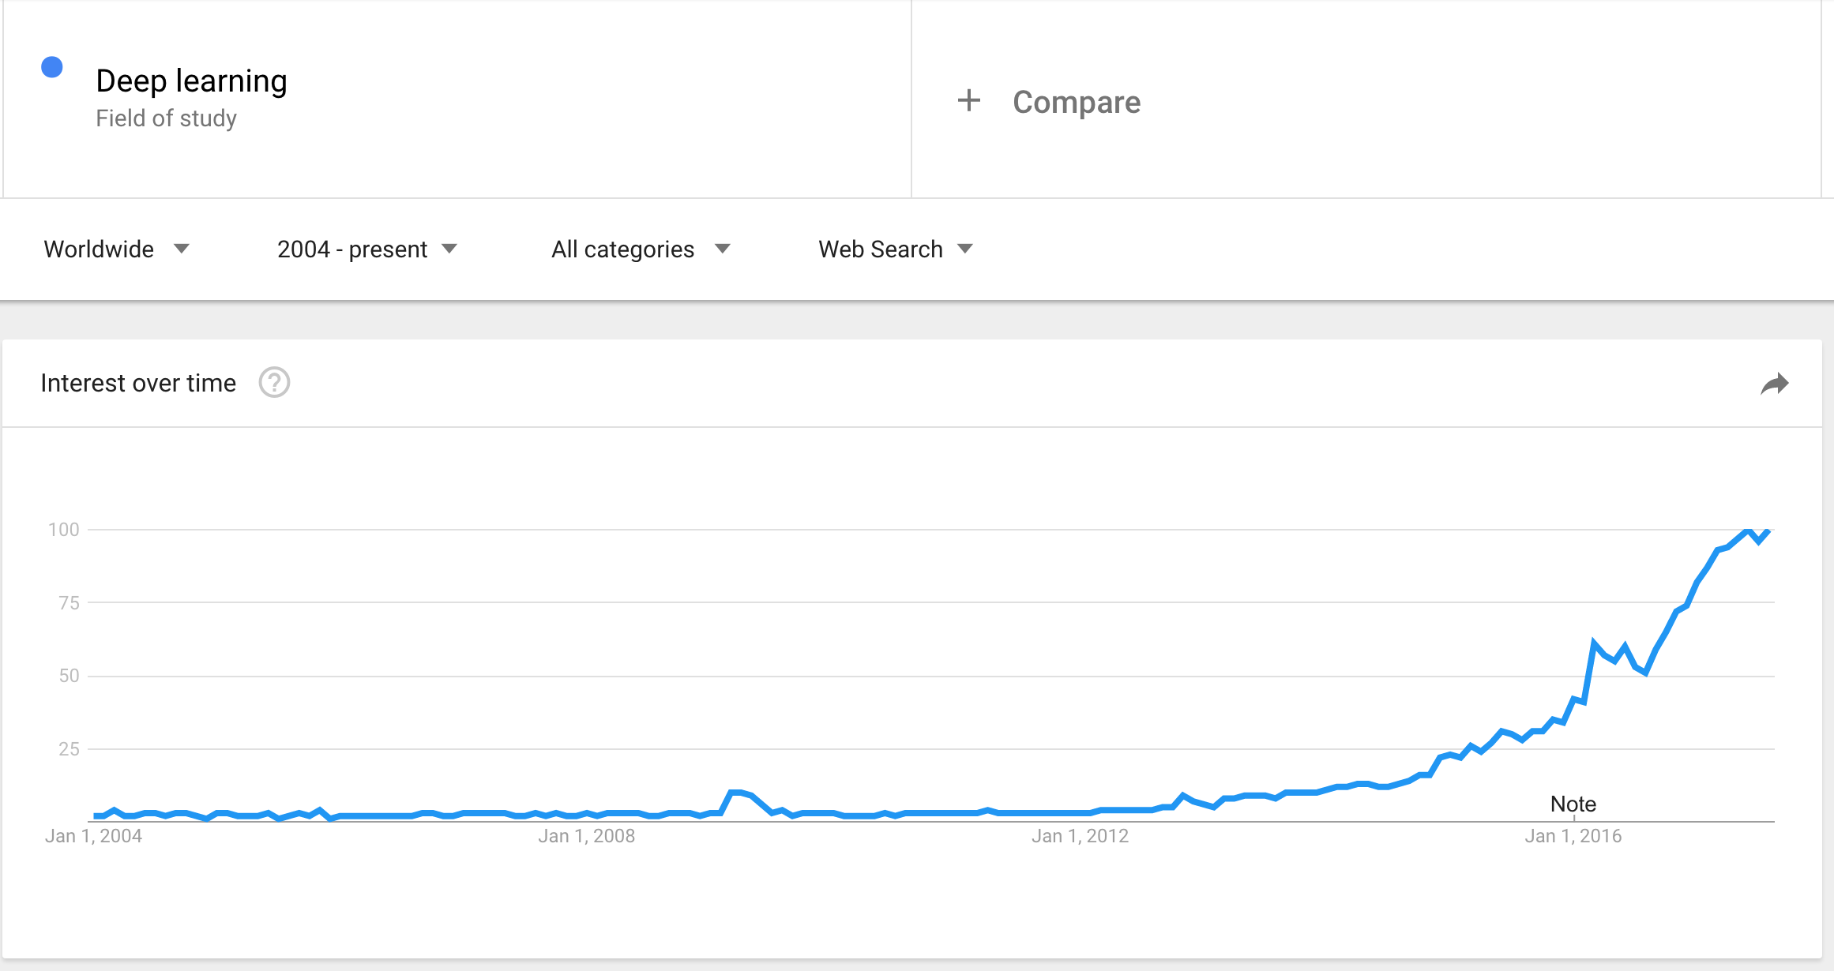
Proxy for public interest

Slide 6
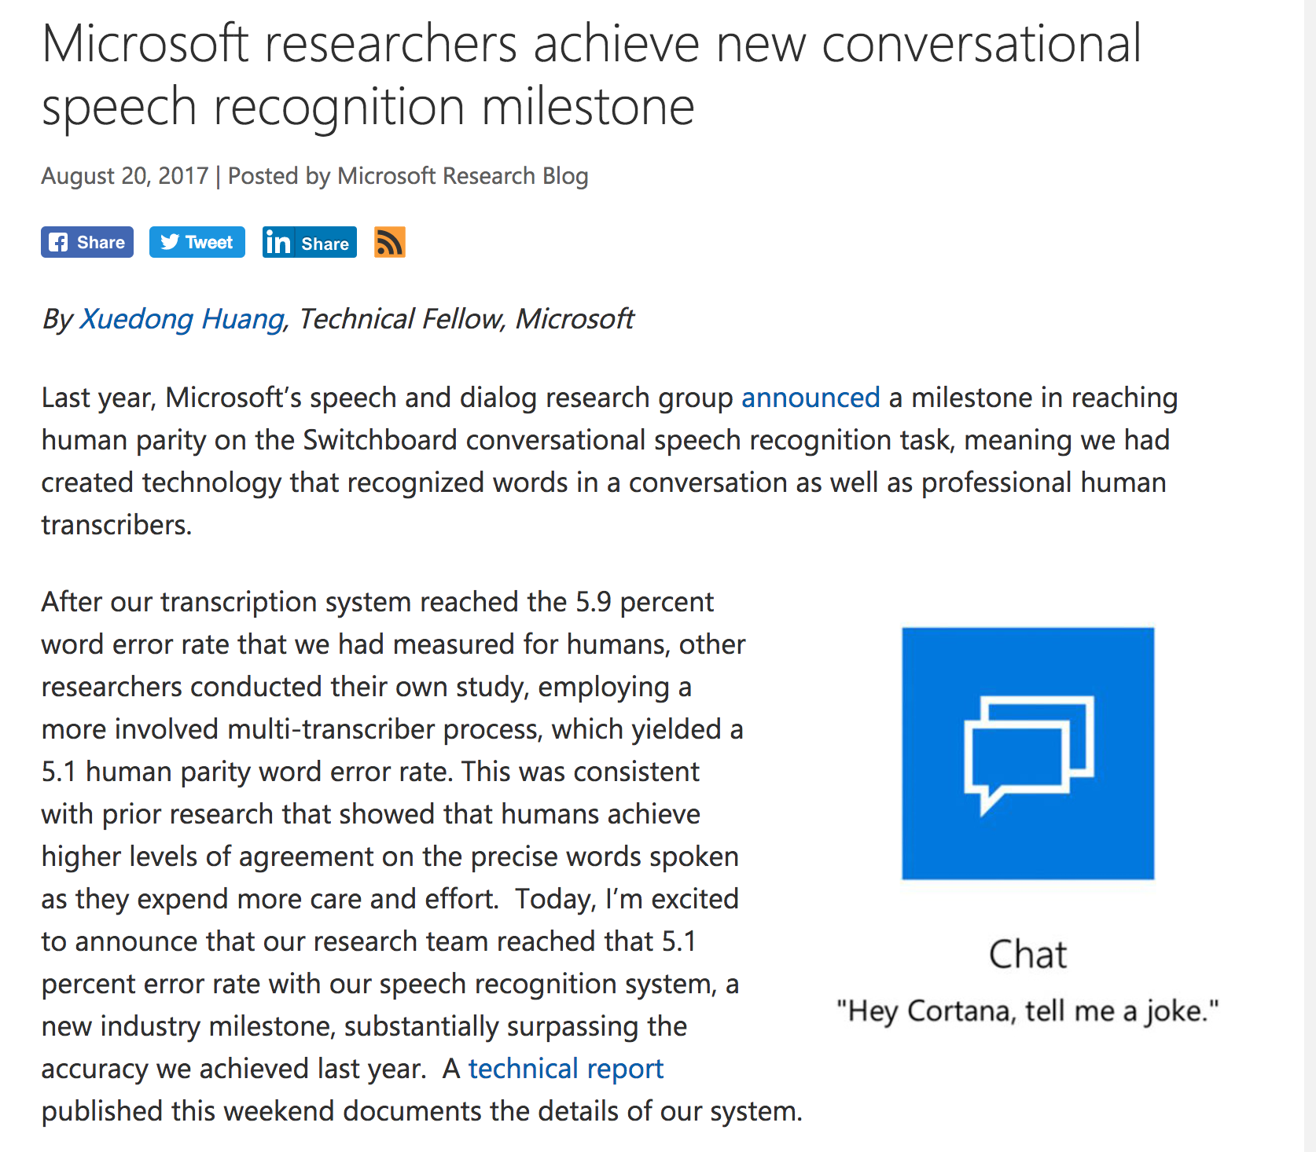

Slide 7
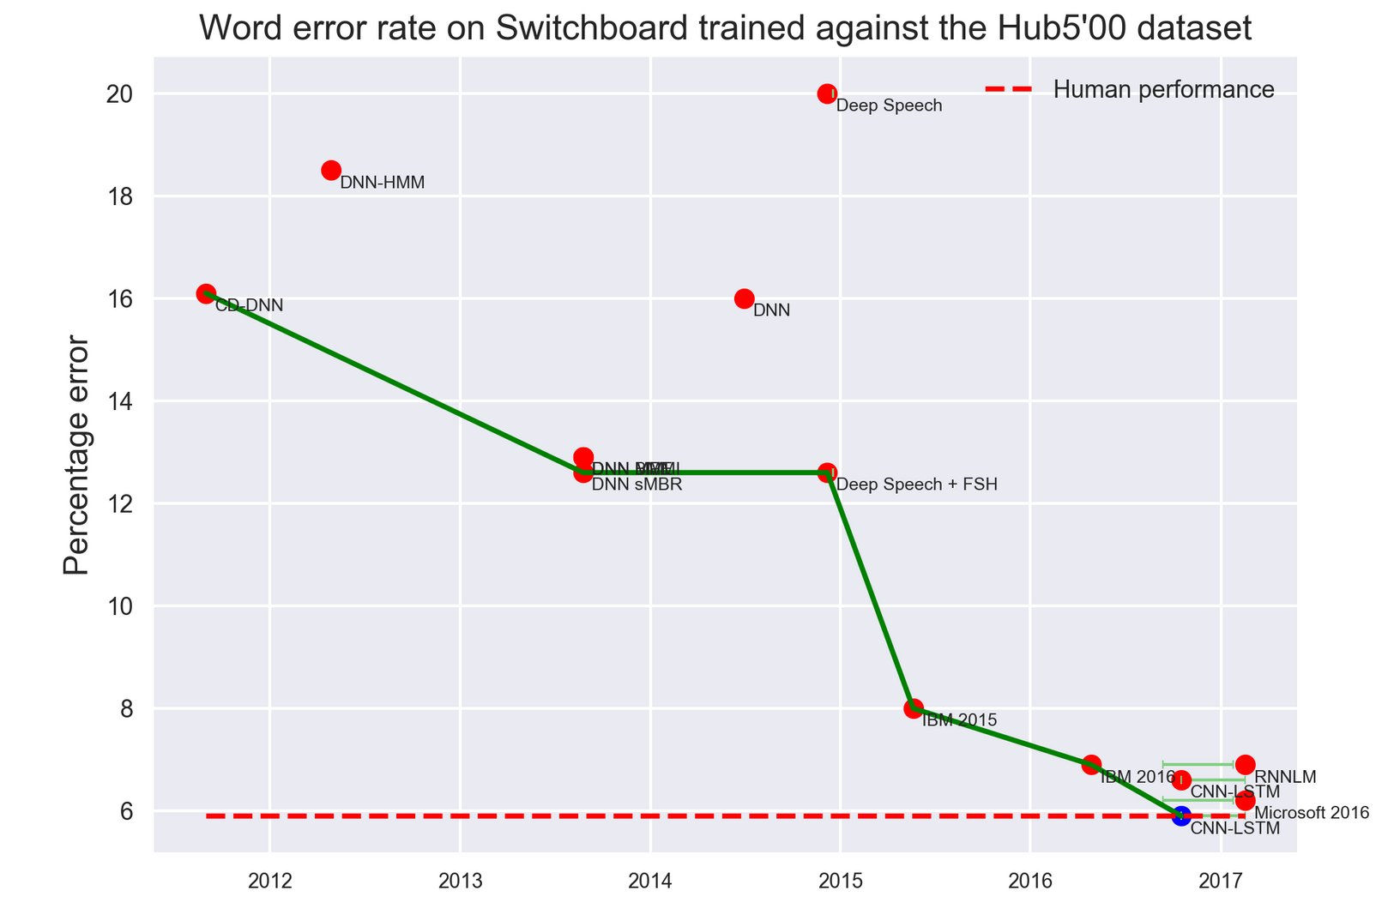
Drop in WER

Slide 8
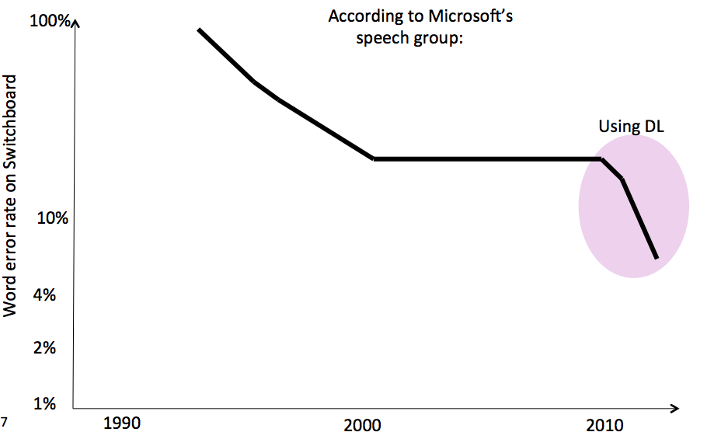
Drop in WER
http://ptgmedia.pearsoncmg.com/images/art_sheil_namerecognition/elementLinks/art_sheil_namerecognition1_alt.png

Slide 9
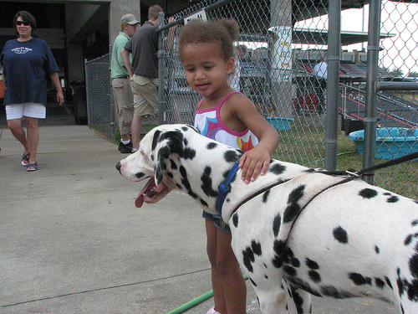
Image Classification
ImageNet Large Scale Visual Recognition Challenge (ILSVRC)
1000 object classes 1.4M/50k/100k images
Person
Dalmatian
http://image-net.org/challenges/LSVRC/{2010,…,2015}

Slide 10
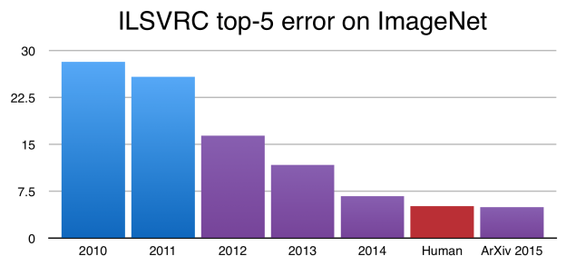
Image Classification

Slide 11
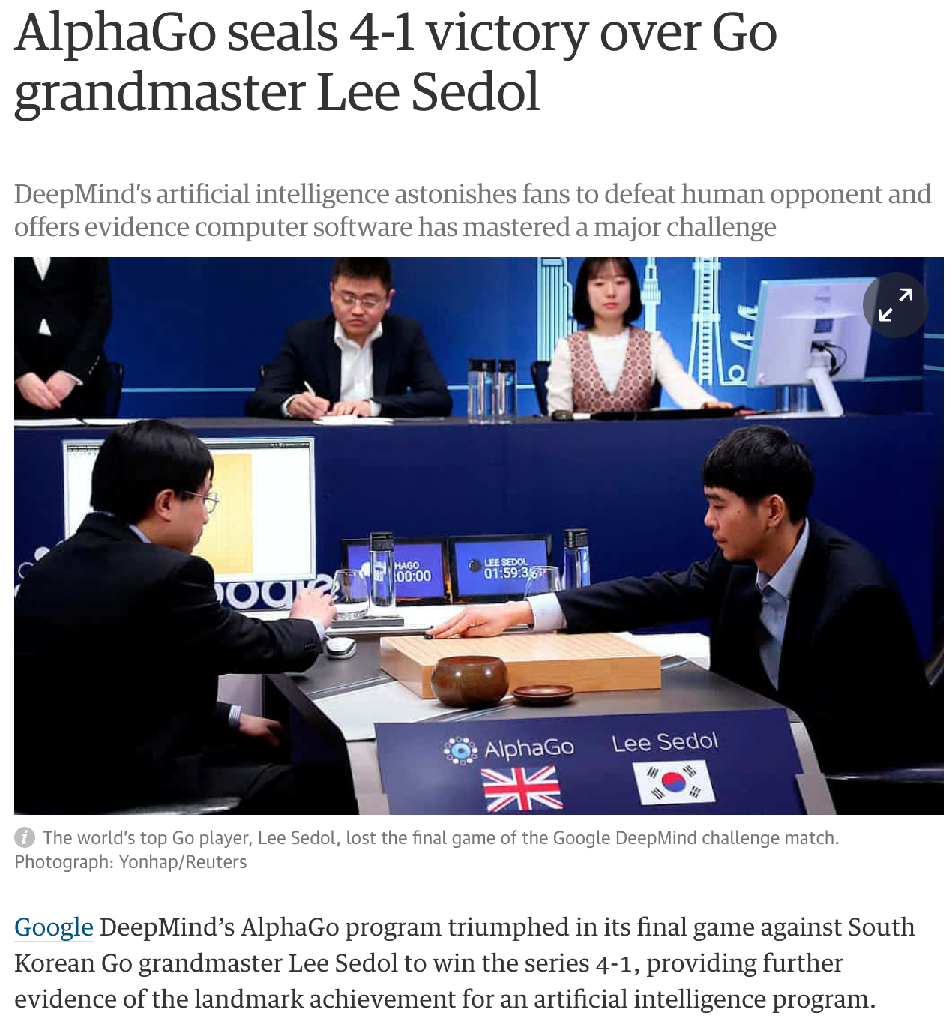
AlphaGo vs Lee Sedol

Slide 12
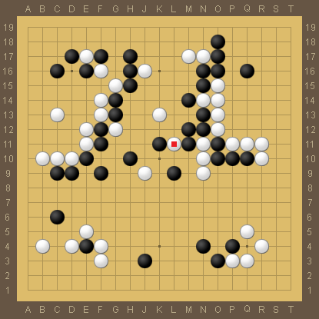
AlphaGo vs Lee Sedol
Match 4, Move 78

Slide 13
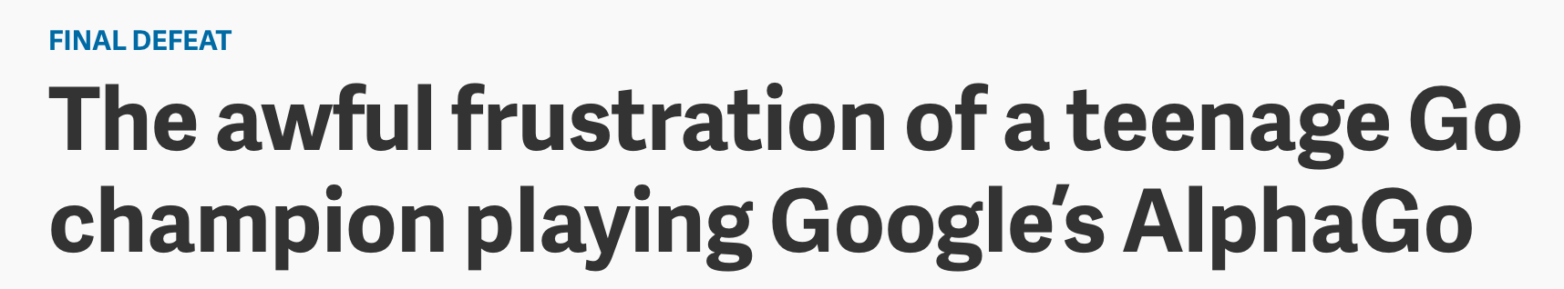
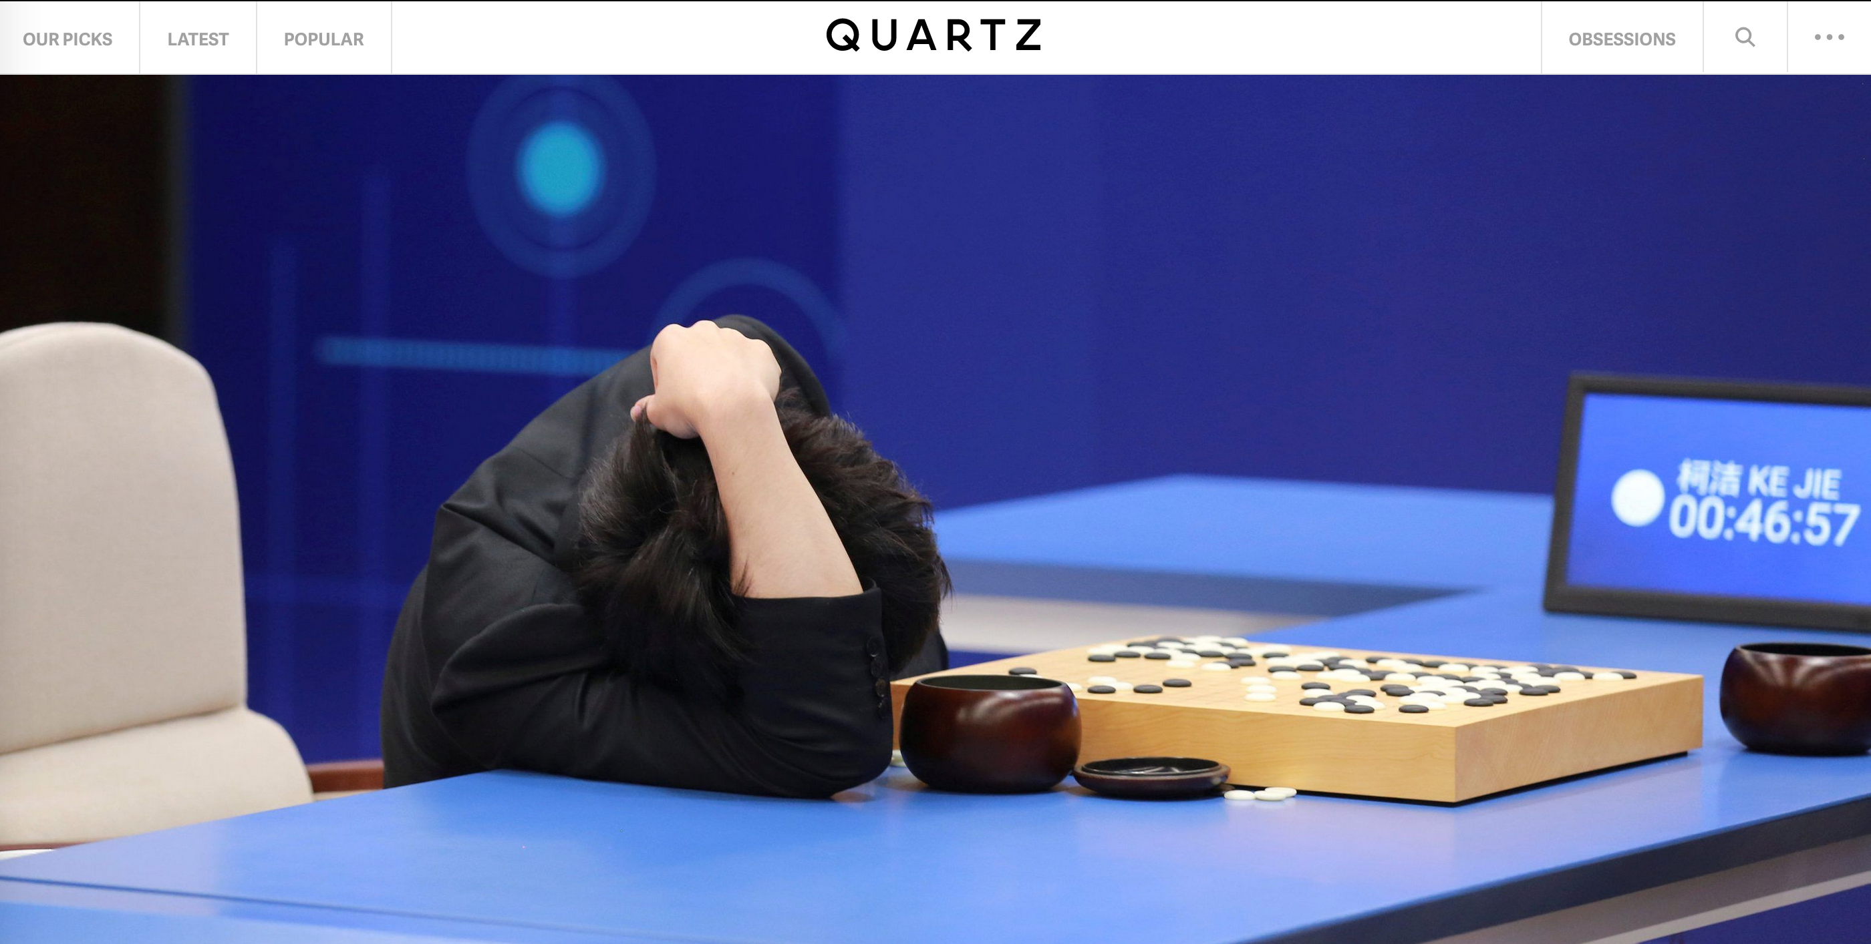
AlphaGo vs Ken Jie

Slide 14
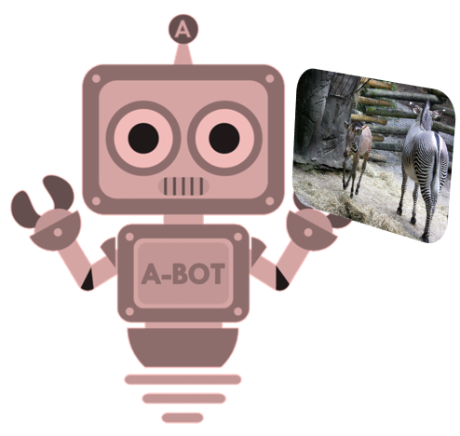
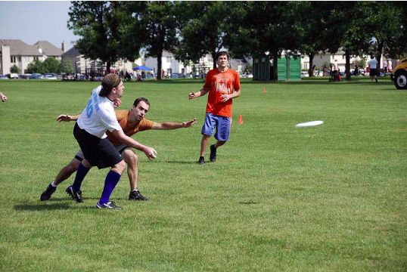
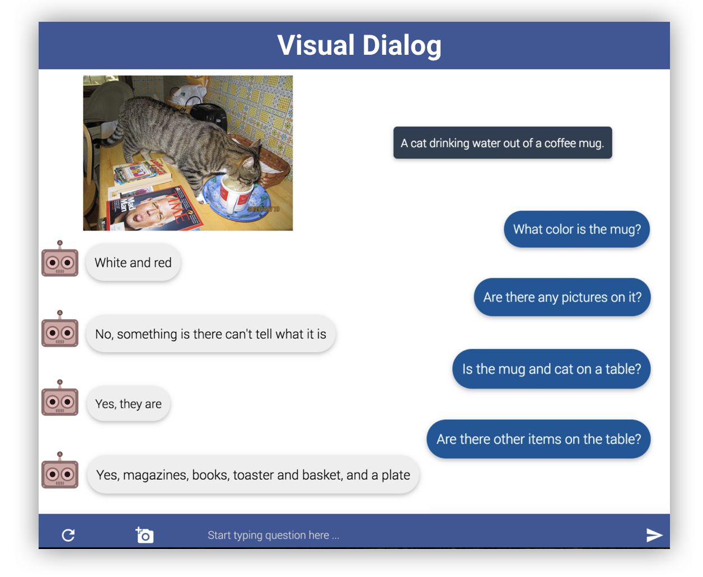
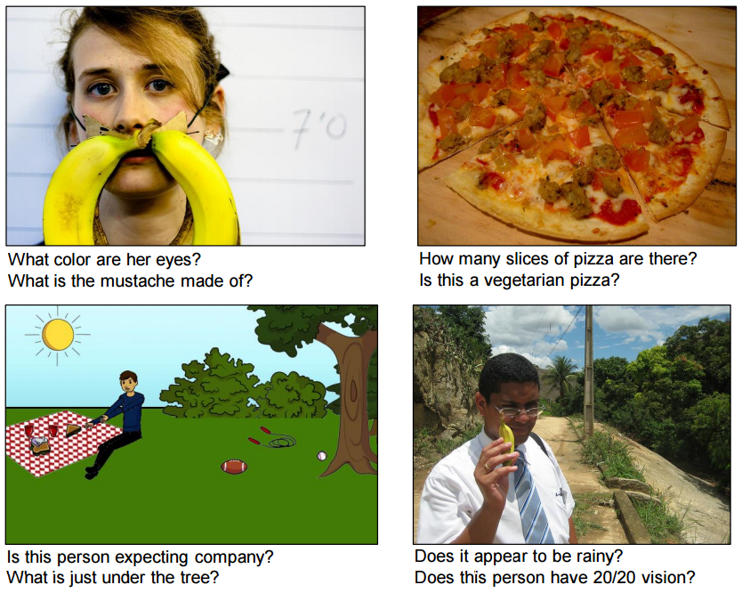
Tasks are getting bolder
A group of young people playing a game of Frisbee
Vinyals et al., 2015
Antol et al., 2015
Das et al., 2017

Slide 15
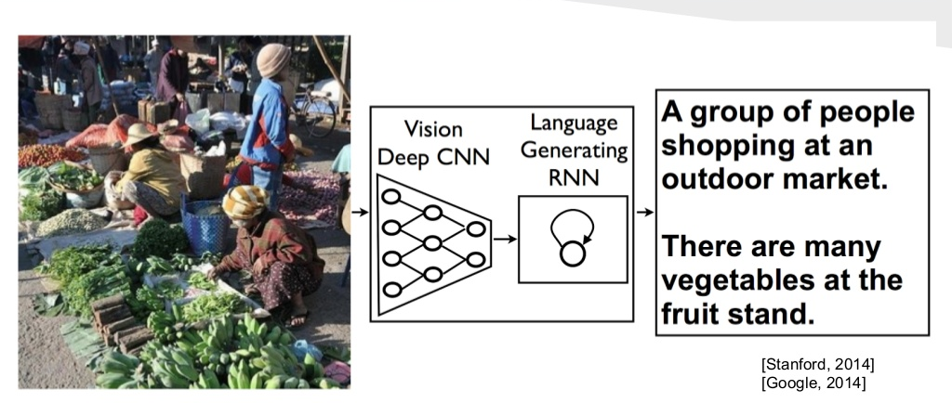
Image Captioning
Image Credit: [Vinyals et al. CVPR15]

Slide 16
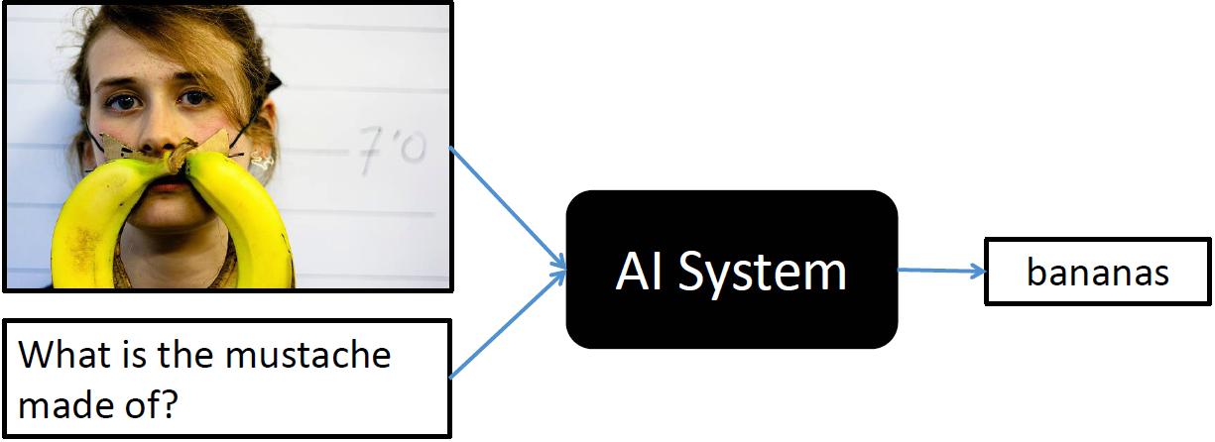
Visual Question Answering (VQA)

Slide 17
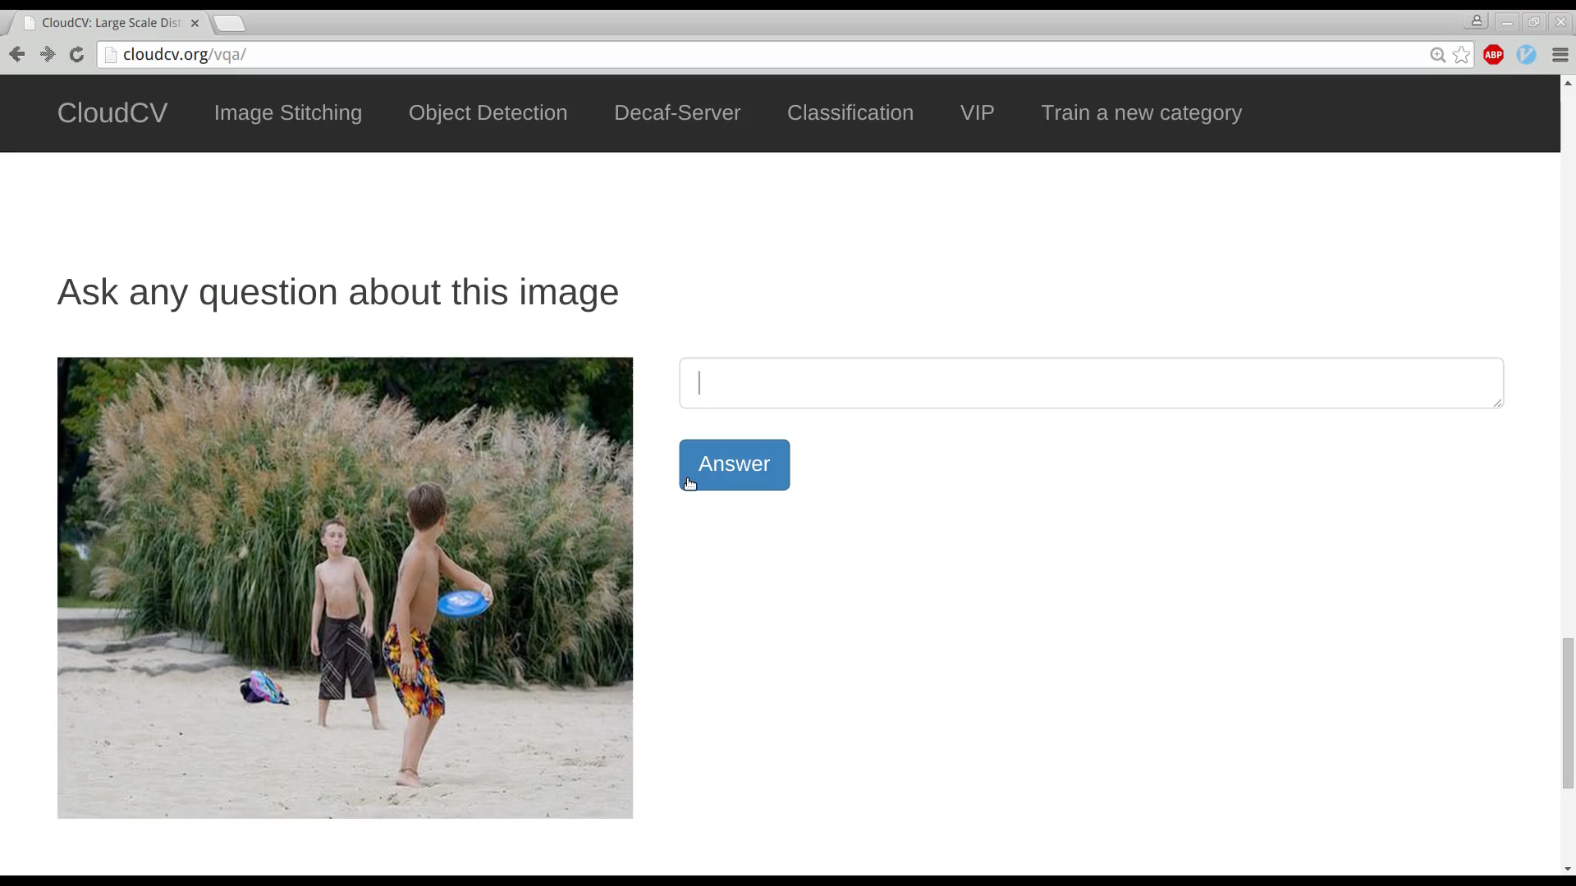
Visual Question Answering (VQA)
Slide Credit: Stan Antol

Slide 18


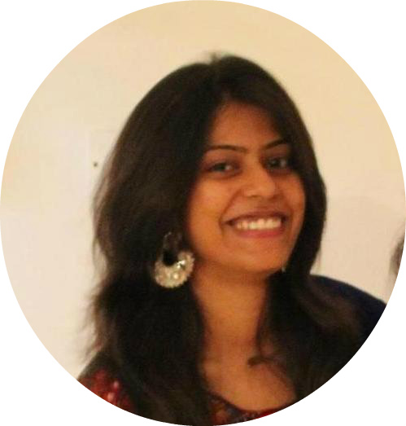
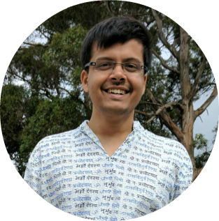

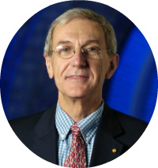
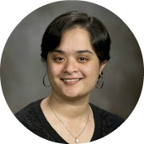
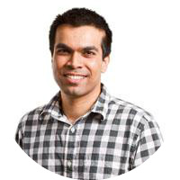
Visual Dialog [CVPR ‘17]
Abhishek Das (Georgia Tech)
Satwik Kottur (CMU)
Khushi Gupta (CMU)
Avi Singh (UC Berkeley)
Deshraj Yadav (Virginia Tech)
José Moura (CMU)
Devi Parikh (Georgia Tech / FAIR)
Dhruv Batra (Georgia Tech / FAIR)

Slide 19
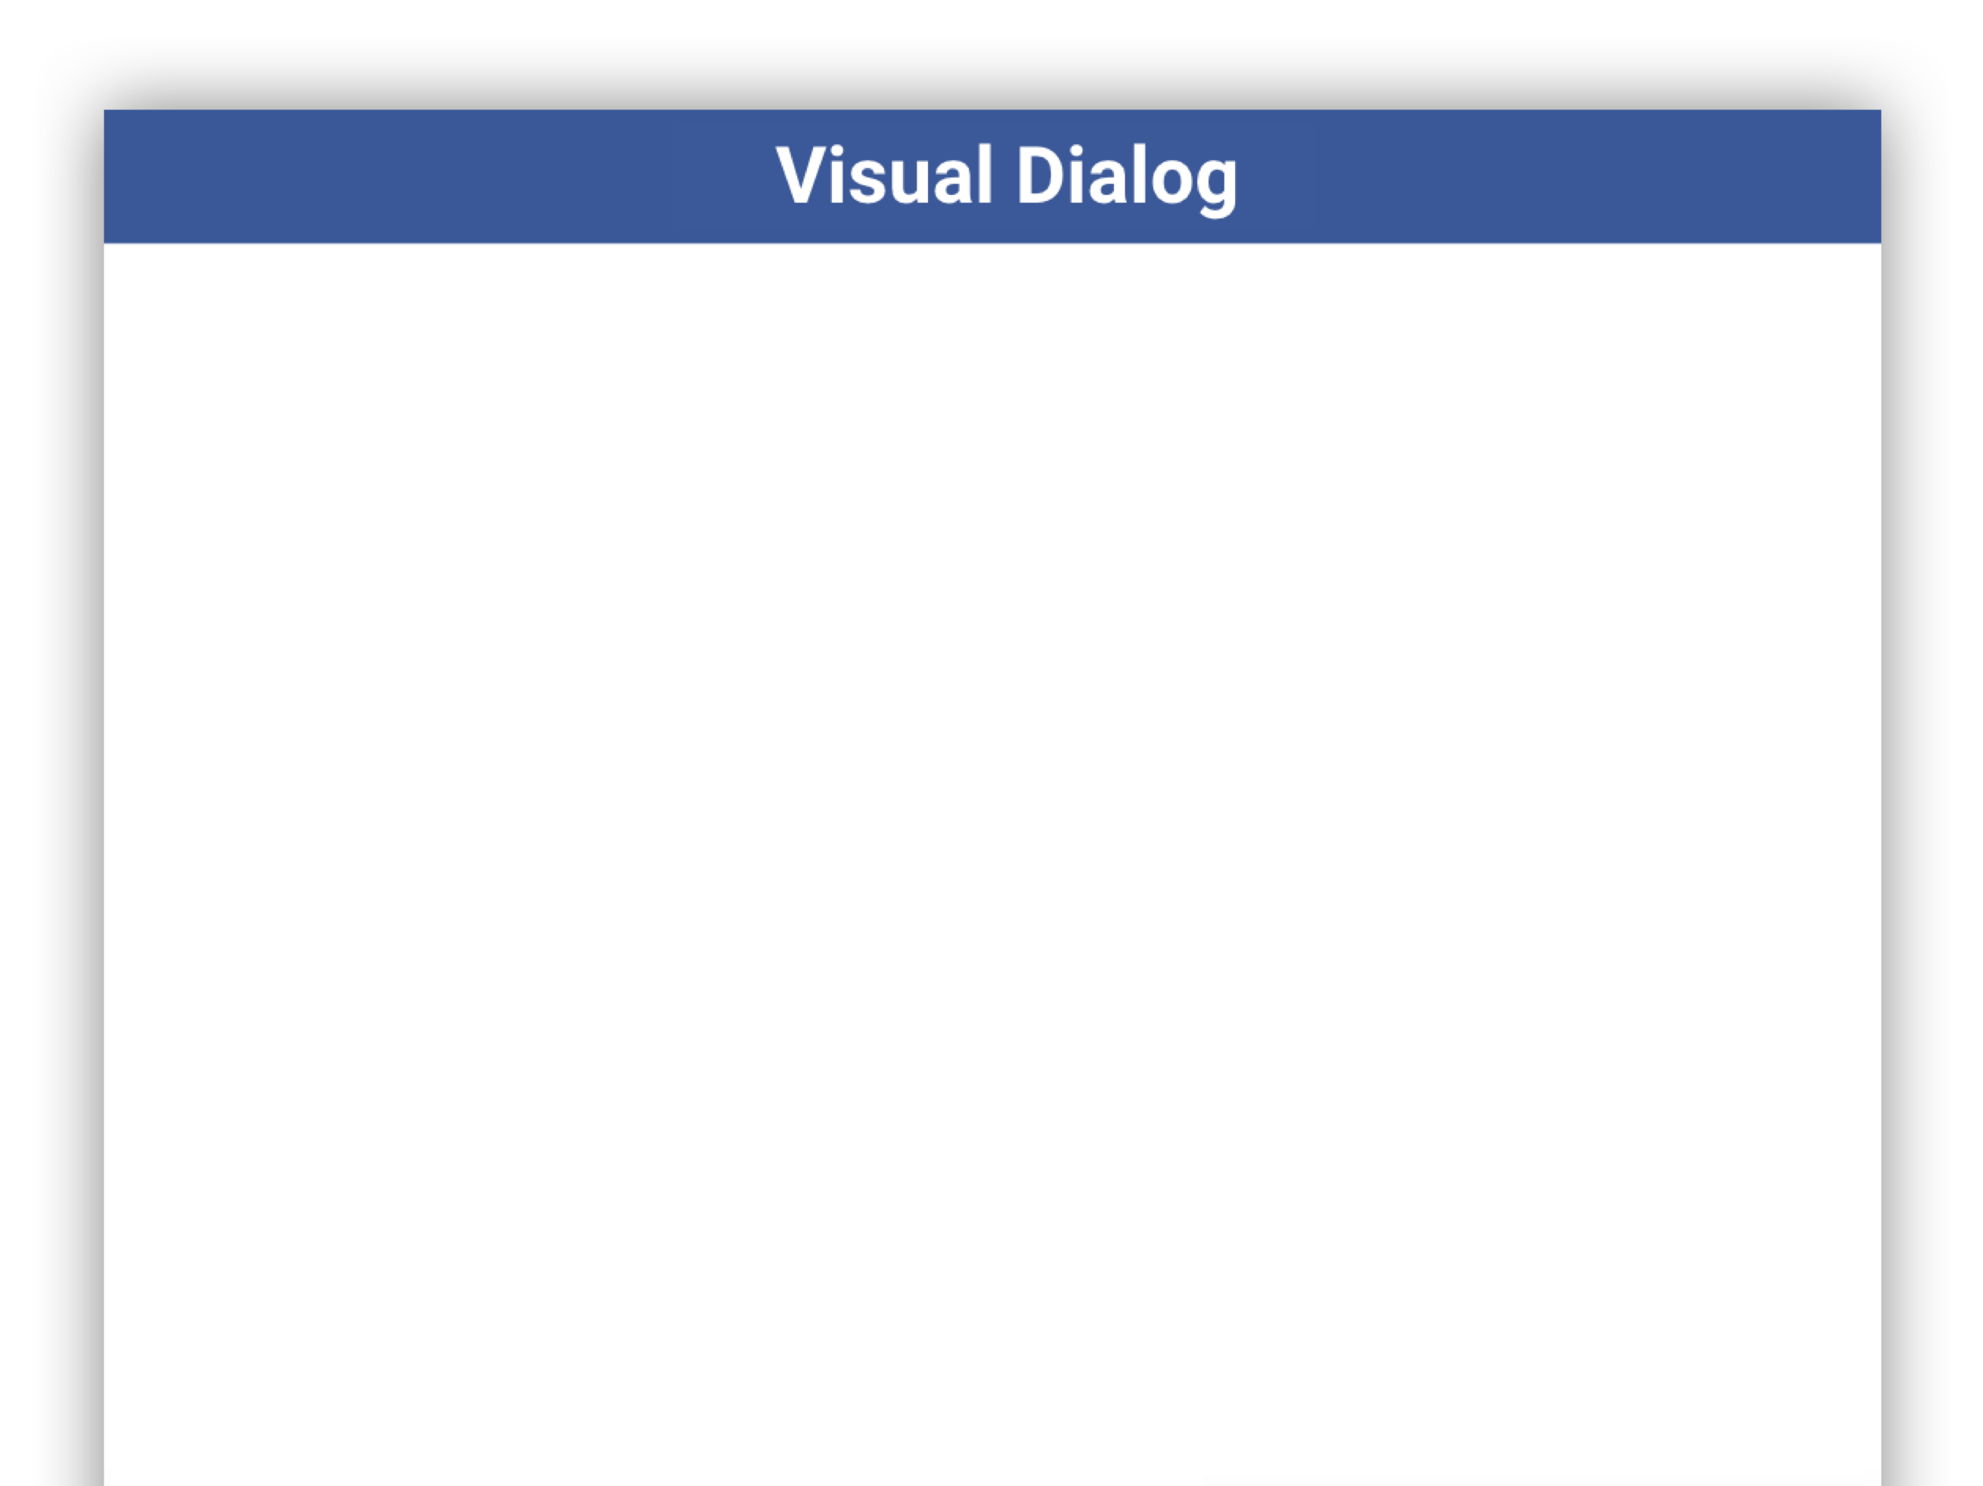

Slide 20
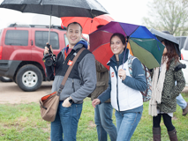

Slide 21

A man and a woman are holding umbrellas

Slide 22

A man and a woman are holding umbrellas
What color is his umbrella?

Slide 23
A man and a woman are holding umbrellas
What color is his umbrella?

Slide 24
A man and a woman are holding umbrellas
What color is his umbrella?

Slide 25
A man and a woman are holding umbrellas
What color is his umbrella?
His umbrella is black

Slide 26
A man and a woman are holding umbrellas
What color is his umbrella?
His umbrella is black
What about hers?

Slide 27
A man and a woman are holding umbrellas
What color is his umbrella?
His umbrella is black
What about hers?

Slide 28
A man and a woman are holding umbrellas
What color is his umbrella?
His umbrella is black
What about hers?

Slide 29
A man and a woman are holding umbrellas
What color is his umbrella?
His umbrella is black
What about hers?
Hers is multi-colored

Slide 30
A man and a woman are holding umbrellas
What color is his umbrella?
His umbrella is black
What about hers?
Hers is multi-colored
How many other people are in the image?

Slide 31
A man and a woman are holding umbrellas
What color is his umbrella?
His umbrella is black
What about hers?
Hers is multi-colored
How many other people are in the image?

Slide 32
A man and a woman are holding umbrellas
What color is his umbrella?
His umbrella is black
What about hers?
Hers is multi-colored
How many other people are in the image?
I think 3. They are occluded

Slide 33
A man and a woman are holding umbrellas
What color is his umbrella?
His umbrella is black
What about hers?
Hers is multi-colored
How many other people are in the image?
I think 3. They are occluded
How many are men?

Slide 34
A man and a woman are holding umbrellas
What color is his umbrella?
His umbrella is black
What about hers?
Hers is multi-colored
How many other people are in the image?
I think 3. They are occluded
How many are men?

Slide 35
Visual Dialog

Slide 36
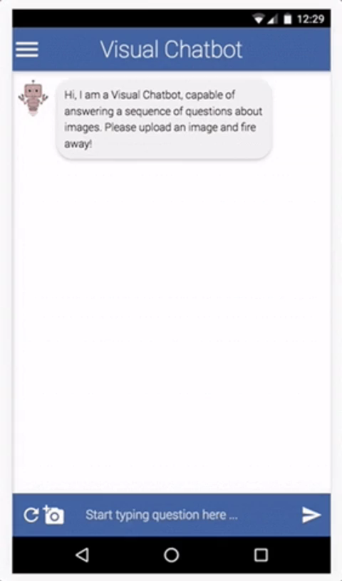
(C) Dhruv Batra
36

Slide 37
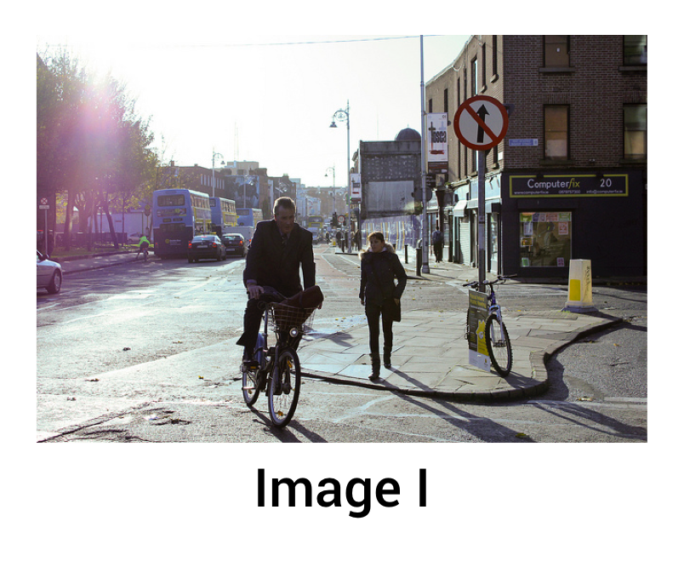
Visual Dialog Model #1
Late Fusion Encoder
Slide Credit: Abhishek Das

Slide 38
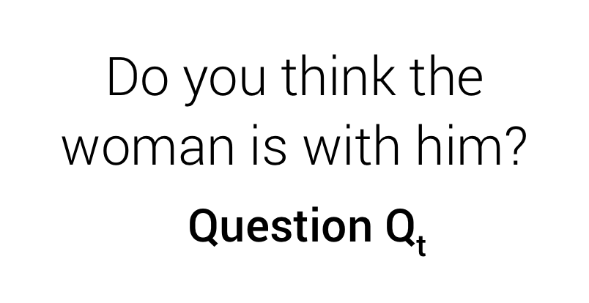
Visual Dialog Model #1
Late Fusion Encoder
Slide Credit: Abhishek Das

Slide 39
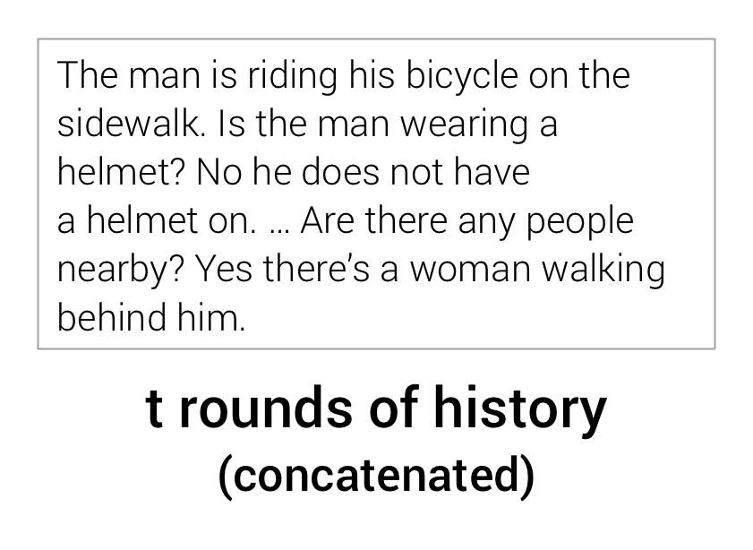
Visual Dialog Model #1
Late Fusion Encoder
Slide Credit: Abhishek Das

Slide 40

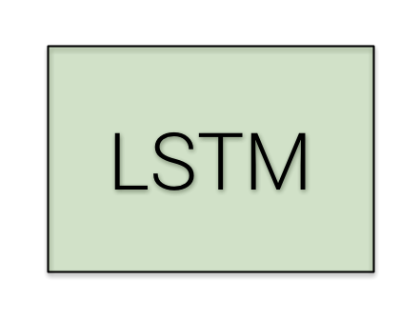
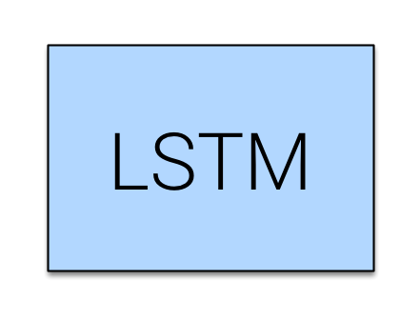
Visual Dialog Model #1
Late Fusion Encoder
Slide Credit: Abhishek Das

Slide 41
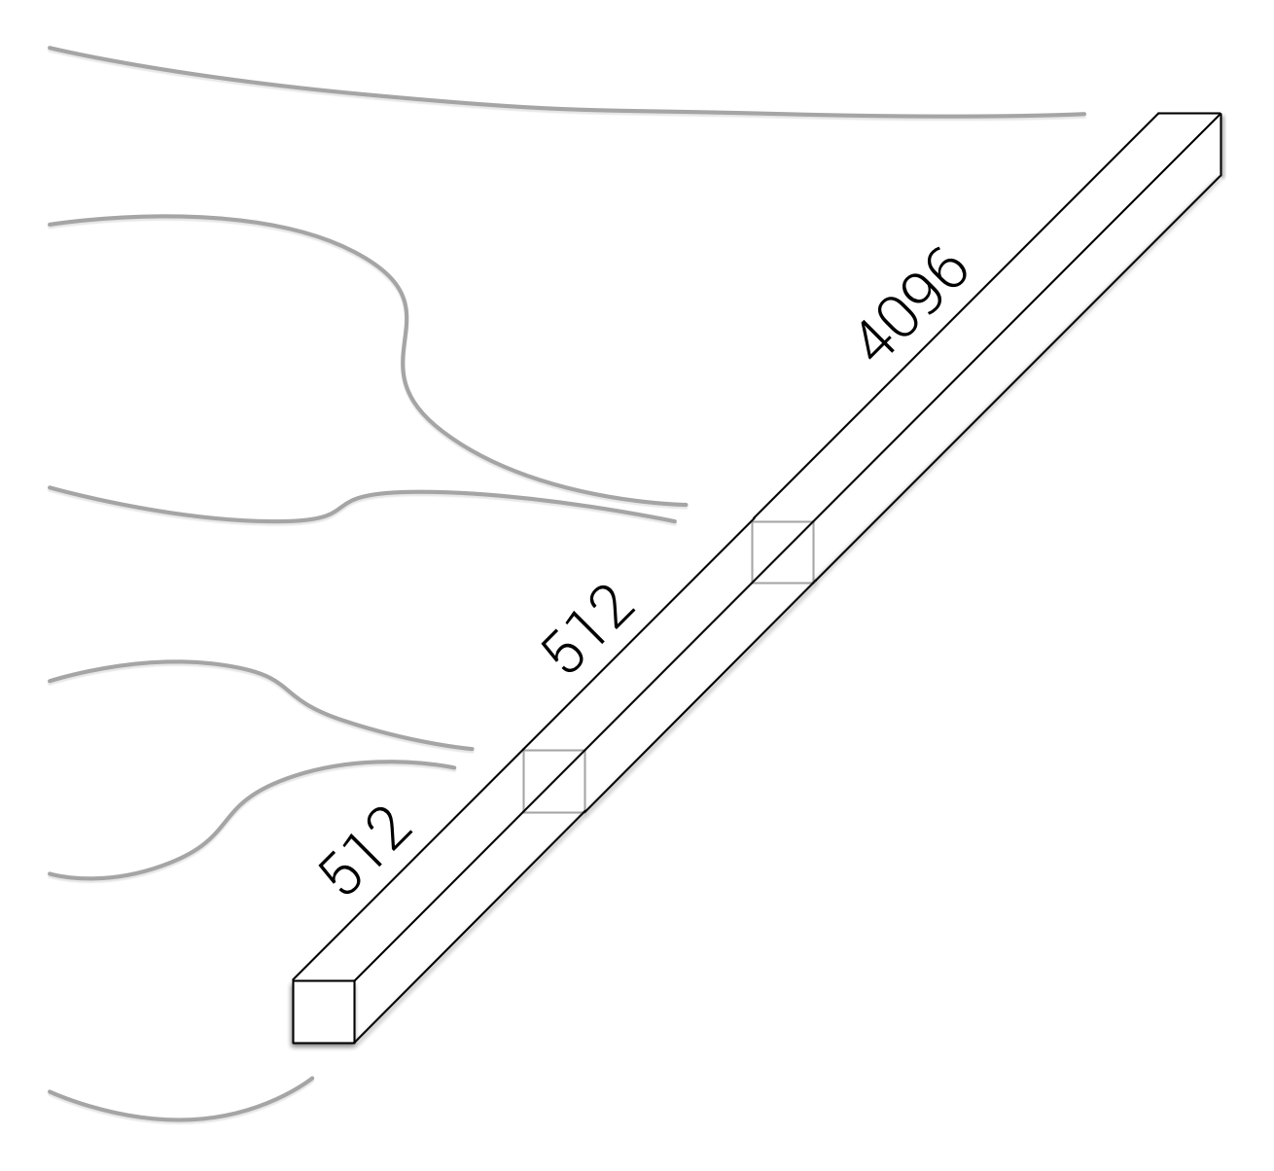
Visual Dialog Model #1
Late Fusion Encoder
Slide Credit: Abhishek Das

Slide 42
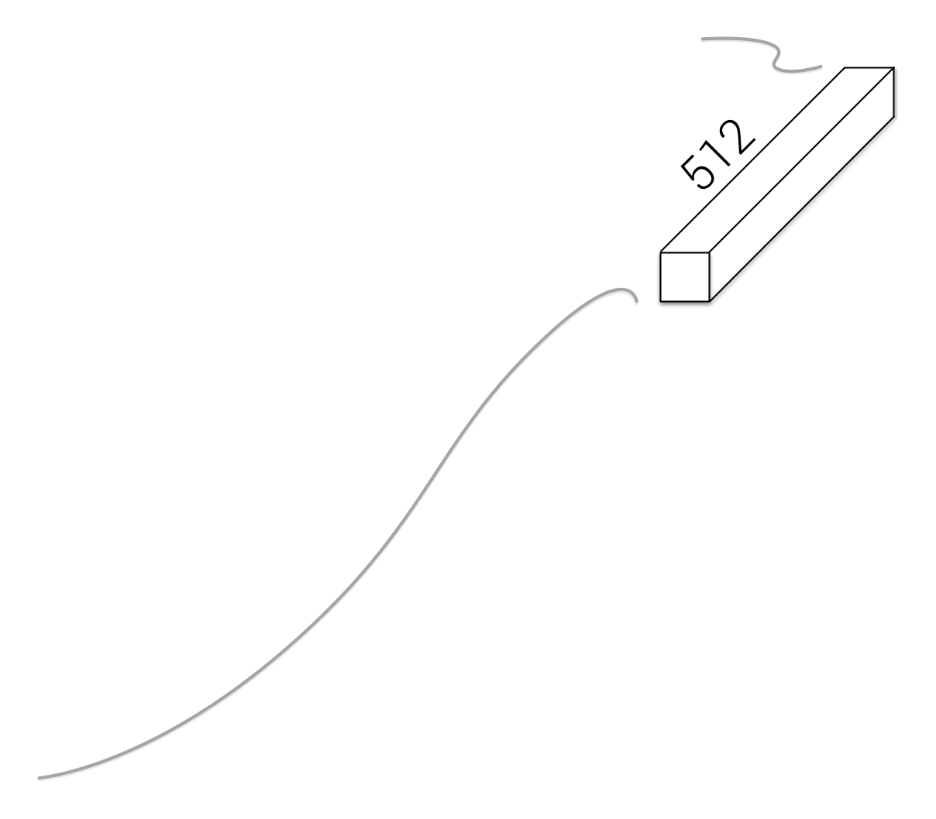
Visual Dialog Model #1
Late Fusion Encoder
Slide Credit: Abhishek Das

Slide 43
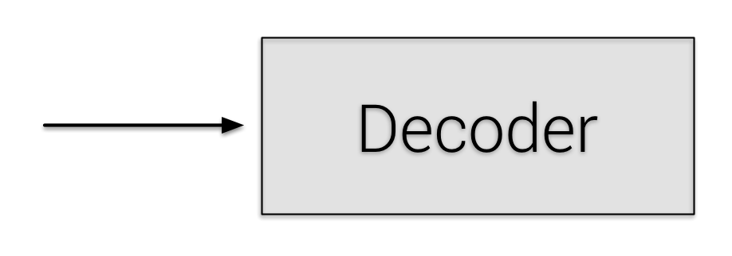
Visual Dialog Model #1
Late Fusion Encoder
Slide Credit: Abhishek Das

Slide 44
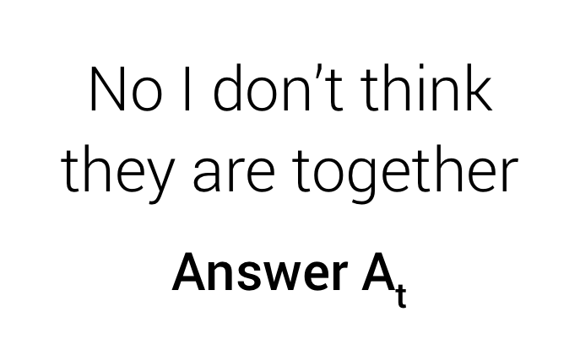
Visual Dialog Model #1
Late Fusion Encoder
Slide Credit: Abhishek Das

Slide 45

Learning Cooperative Visual Dialog Agents with Deep Reinforcement Learning [ICCV ‘17]
Abhishek Das* (Georgia Tech)
Satwik Kottur* (CMU)
José Moura (CMU)
Stefan Lee (Virginia Tech)
Dhruv Batra (Georgia Tech / FAIR)

Slide 46


GuessWhich: Image Guessing Game
Slide Credit: Abhishek Das

Slide 47
GuessWhich: Image Guessing Game
Q-Bot
asks questions
is blindfolded
Slide Credit: Abhishek Das

Slide 48

GuessWhich: Image Guessing Game
asks questions
Q-Bot
is blindfolded
Slide Credit: Abhishek Das

Slide 49
GuessWhich: Image Guessing Game
asks questions
A-Bot
answers questions
sees an image
Slide Credit: Abhishek Das

Slide 50
GuessWhich: Image Guessing Game
asks questions
answers questions
A-Bot
sees an image
Slide Credit: Abhishek Das

Slide 51
GuessWhich: Image Guessing Game
asks questions
Slide Credit: Abhishek Das

Slide 52




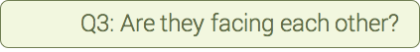

GuessWhich: Image Guessing Game
asks questions
Slide Credit: Abhishek Das

Slide 53
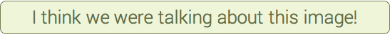
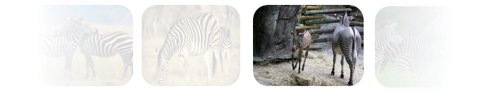
GuessWhich: Image Guessing Game
asks questions
Slide Credit: Abhishek Das

Slide 54
Turing Test

Slide 55
Natural Language Does Not Emerge 'Naturally' in Multi-Agent Dialog [EMNLP ‘17] Best Paper Award
Satwik Kottur* (CMU)
José Moura (CMU)
Stefan Lee (Virginia Tech)
Dhruv Batra (Georgia Tech / FAIR)

Slide 56
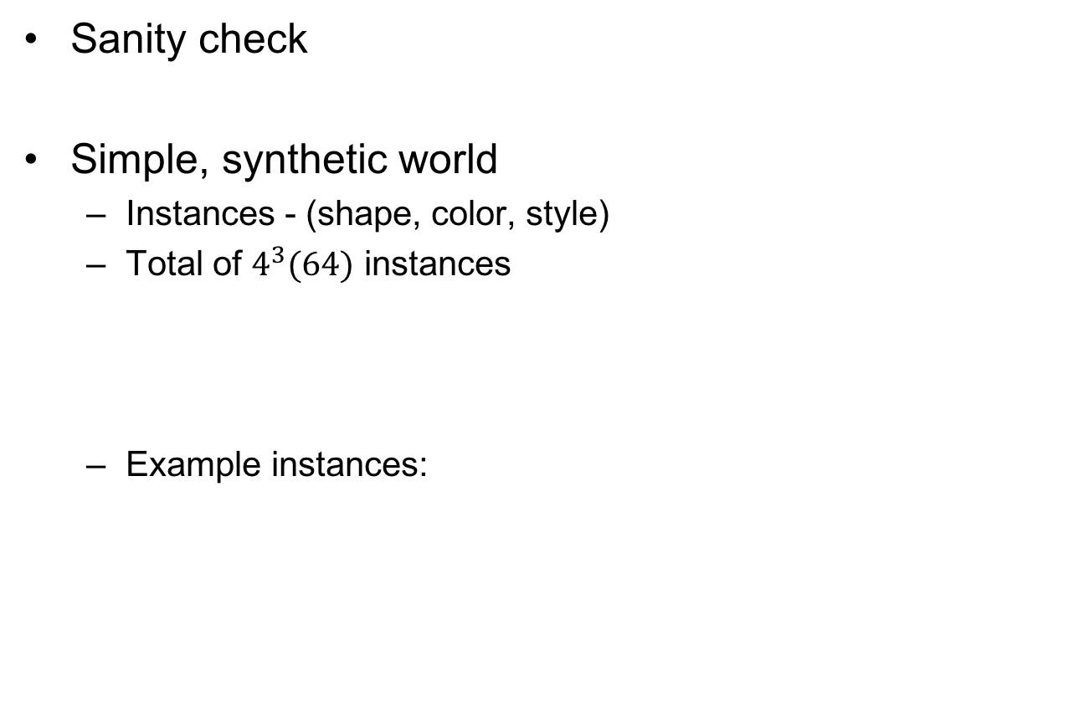
Toy World
Sanity check
Simple, synthetic world
Instances - (shape, color, style)
Total of $4^{3}(64)$ instances
Example instances:
shape
color
style
triangle
blue
filled
square
green
dashed
circle
red
dotted
star
purple
solid
(triangle, purple, filled)
(square, blue, solid)
(circle, blue, dotted)
Slide Credit: Satwik Kottur

Slide 57


Task & Talk
Task (G)
Inquire pair of attributes
(color, shape), (shape, color)
Talk
Single token per round
Two rounds
Q-bot guesses a pair
Reward : +1 / -1
Prediction order matters!
Instance
(purple, square, filled)
Q1: Y
Task
(color, shape)
A1: 2
Q2: Z
A2: 3
Guess: (purple, square)
Get reward!
Slide Credit: Satwik Kottur

Slide 58
Emergence of Grounded Dialog
T: (style, color)
P: (solid, green)
X
3
Z
4
color?
green
style?
solid
T: (style, shape)
P: (filled, triangle)
Y
1
Z
2
shape?
triangle
style?
filled

Slide 59

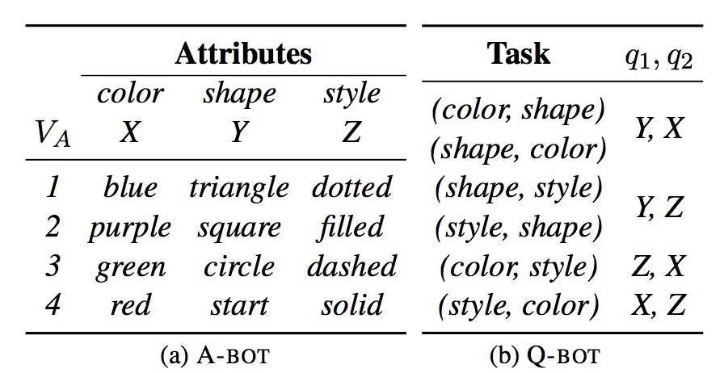
Emergence of Grounded Dialog
Compositional grounding
Predict dialog for unseen instances
Task
(color, shape)
Q1: Y
Q1: 2
Q2: X
Q2: 2

Slide 60
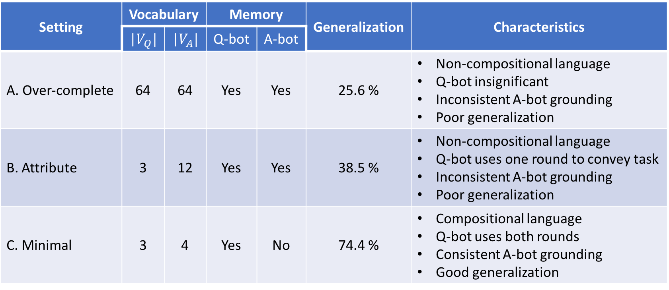
Summary of findings
Setting | Vocabulary |  | Memory |  | Generalization | Characteristics
 | |$V_{Q}|$ | |$V_{A}|$ | Q-bot | A-bot
A. Over-complete | 64 | 64 | Yes | Yes | 25.6 % | Non-compositional language Q-bot insignificant Inconsistent A-bot grounding Poor generalization
B. Attribute | 3 | 12 | Yes | Yes | 38.5 % | Non-compositional language Q-bot uses one round to convey task Inconsistent A-bot grounding Poor generalization
C. Minimal | 3 | 4 | Yes | No | 74.4 % | Compositional language Q-bot uses both rounds Consistent A-bot grounding Good generalization

Slide 61
Deep Multi-Agent Communication
NIPS ‘16
[DeepMind] Learning to Communicate with Deep Multi-Agent Reinforcement Learning. Jakob N. Foerster, Yannis M. Assael, Nando de Freitas, Shimon Whiteson. NIPS ‘16.
[NYU / FAIR] Learning Multiagent Communication with Backpropagation. Sainbayar Sukhbaatar, Arthur Szlam, Rob Fergus. NIPS ‘16.
Arxiv ‘17
[OpenAI] Emergence of Grounded Compositional Language in Multi-Agent Populations. Igor Mordatch, Pieter Abbeel.
[FAIR] Multi-Agent Cooperation and the Emergence of (Natural) Language. Angeliki Lazaridou, Alexander Peysakhovich, Marco Baroni.
Learning to play guess who? and inventing a grounded language as a consequence. Emilio Jorge, Mikael Kågebäck, and Emil Gustavsson.
Emergence of language with multi-agent games: Learning to communicate with sequences of symbols. Serhii Havrylov and Ivan Titov.
[Berkeley] Translating neuralese. Jacob Andreas, Anca Dragan and Dan Klein. ACL 2017.

Slide 62
So what is Deep (Machine) Learning?
Representation Learning
Neural Networks
Deep Unsupervised/Reinforcement/Structured/ <insert-qualifier-here> Learning
Simply: Deep Learning

Slide 63
So what is Deep (Machine) Learning?
A few different ideas:
(Hierarchical) Compositionality
Cascade of non-linear transformations
Multiple layers of representations
End-to-End Learning
Learning (goal-driven) representations
Learning to feature extraction
Distributed Representations
No single neuron “encodes” everything
Groups of neurons work together

Slide 64
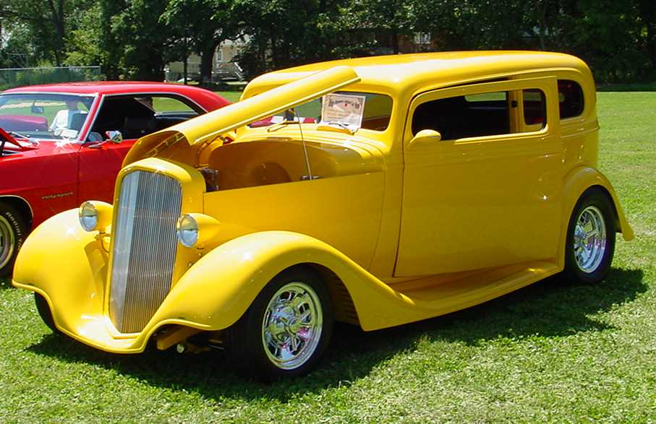
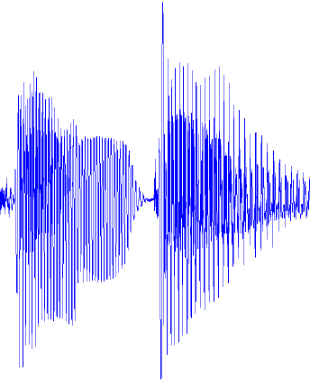
Traditional Machine Learning
VISION
hand-crafted features
SIFT/HOG
your favorite classifier
“car”
fixed
learned
SPEECH
hand-crafted features
MFCC
your favorite classifier
\ˈd ē p\
fixed
learned
NLP
hand-crafted features
Bag-of-words
your favorite classifier
This burrito place
is yummy and fun!
“+”
fixed
learned
Slide Credit: Marc'Aurelio Ranzato, Yann LeCun

Slide 65
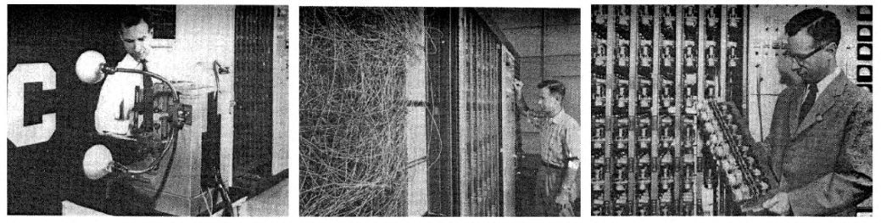
It’s an old paradigm
The first learning machine: the Perceptron
Built at Cornell in 1960
The Perceptron was a linear classifier on top of a simple feature extractor
The vast majority of practical applications of ML today use glorified linear classifiers or glorified template matching.
Designing a feature extractor requires considerable efforts by experts.
A
Feature Extractor
W_{i}
Slide Credit: Marc'Aurelio Ranzato, Yann LeCun

Slide 66
Hierarchical Compositionality
VISION
pixels
edge
texton
motif
part
object
SPEECH
sample
spectral band
formant
motif
phone
word
NLP
character
word
NP/VP/..
clause
sentence
story
Slide Credit: Marc'Aurelio Ranzato, Yann LeCun

Slide 67
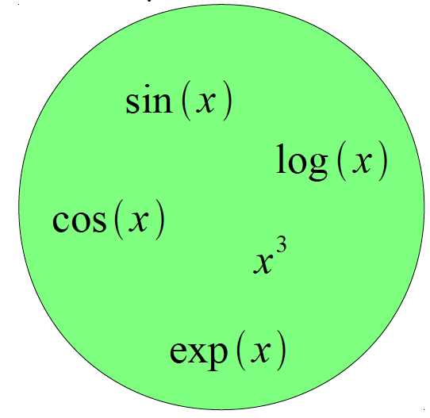
Building A Complicated Function
Given a library of simple functions
Compose into a
complicate function
Slide Credit: Marc'Aurelio Ranzato, Yann LeCun

Slide 68

Building A Complicated Function
Given a library of simple functions
Idea 1: Linear Combinations
Boosting
Kernels
…
Compose into a
complicate function
Slide Credit: Marc'Aurelio Ranzato, Yann LeCun

Slide 69

Building A Complicated Function
Given a library of simple functions
Idea 2: Compositions
Deep Learning
Grammar models
Scattering transforms…
Compose into a
complicate function
Slide Credit: Marc'Aurelio Ranzato, Yann LeCun

Slide 70

Building A Complicated Function
Given a library of simple functions
Idea 2: Compositions
Deep Learning
Grammar models
Scattering transforms…
Compose into a
complicate function
Slide Credit: Marc'Aurelio Ranzato, Yann LeCun

Slide 71
Deep Learning = Hierarchical Compositionality
“car”
Slide Credit: Marc'Aurelio Ranzato, Yann LeCun

Slide 72



Deep Learning = Hierarchical Compositionality
Low-Level Feature
Mid-Level Feature
High-Level Feature
Trainable Classifier
“car”
Feature visualization of convolutional net trained on ImageNet from [Zeiler & Fergus 2013]
Slide Credit: Marc'Aurelio Ranzato, Yann LeCun

Slide 73

Sparse DBNs
[Lee et al. ICML ‘09]
Figure courtesy: Quoc Le

Slide 74

The Mammalian Visual Cortex is Hierarchical
The ventral (recognition) pathway in the visual cortex
[picture from Simon Thorpe]
Slide Credit: Marc'Aurelio Ranzato, Yann LeCun

Slide 75
So what is Deep (Machine) Learning?
A few different ideas:
(Hierarchical) Compositionality
Cascade of non-linear transformations
Multiple layers of representations
End-to-End Learning
Learning (goal-driven) representations
Learning to feature extraction
Distributed Representations
No single neuron “encodes” everything
Groups of neurons work together

Slide 76
Traditional Machine Learning
VISION
hand-crafted features
SIFT/HOG
your favorite classifier
“car”
fixed
learned
SPEECH
hand-crafted features
MFCC
your favorite classifier
\ˈd ē p\
fixed
learned
NLP
hand-crafted features
Bag-of-words
your favorite classifier
This burrito place
is yummy and fun!
“+”
fixed
learned
Slide Credit: Marc'Aurelio Ranzato, Yann LeCun

Slide 77







Feature Engineering
SIFT
Spin Images
HoG
Textons
and many many more….

Slide 78

What are the current bottlenecks?
Ablation studies on DPM [Parikh & Zitnick, CVPR10]
Replace every “component” in the model with a human
Key takeaway: “parts” or features are the most important!

Slide 79
Traditional Machine Learning (more accurately)
“Learned”
VISION
SIFT/HOG
K-Means/
pooling
classifier
“car”
fixed
unsupervised
supervised
SPEECH
MFCC
Mixture of
Gaussians
classifier
\ˈd ē p\
fixed
unsupervised
supervised
NLP
Parse Tree
Syntactic
n-grams
classifier
This burrito place
is yummy and fun!
“+”
fixed
unsupervised
supervised
Slide Credit: Marc'Aurelio Ranzato, Yann LeCun

Slide 80
Deep Learning = End-to-End Learning
“Learned”
VISION
SIFT/HOG
K-Means/
pooling
classifier
“car”
fixed
unsupervised
supervised
SPEECH
MFCC
Mixture of
Gaussians
classifier
\ˈd ē p\
fixed
unsupervised
supervised
NLP
Parse Tree
Syntactic
n-grams
classifier
This burrito place
is yummy and fun!
“+”
fixed
unsupervised
supervised
Slide Credit: Marc'Aurelio Ranzato, Yann LeCun

Slide 81
Deep Learning = End-to-End Learning
A hierarchy of trainable feature transforms
Each module transforms its input representation into a higher-level one.
High-level features are more global and more invariant
Low-level features are shared among categories
Trainable Feature-Transform / Classifier
Trainable Feature-Transform / Classifier
Trainable Feature-Transform / Classifier
Learned Internal Representations
Slide Credit: Marc'Aurelio Ranzato, Yann LeCun

Slide 82
“Shallow” vs Deep Learning
“Shallow” models
Deep models
hand-crafted
Feature Extractor
“Simple” Trainable
Classifier
fixed
learned
Trainable Feature-Transform / Classifier
Trainable Feature-Transform / Classifier
Trainable Feature-Transform / Classifier
Learned Internal Representations
Slide Credit: Marc'Aurelio Ranzato, Yann LeCun

Slide 83
So what is Deep (Machine) Learning?
A few different ideas:
(Hierarchical) Compositionality
Cascade of non-linear transformations
Multiple layers of representations
End-to-End Learning
Learning (goal-driven) representations
Learning to feature extraction
Distributed Representations
No single neuron “encodes” everything
Groups of neurons work together

Slide 84

Distributed Representations Toy Example
Local vs Distributed
Slide Credit: Moontae Lee

Slide 85

Distributed Representations Toy Example
Can we interpret each dimension?
Slide Credit: Moontae Lee

Slide 86

Power of distributed representations!
Local
Distributed
Slide Credit: Moontae Lee

Slide 87

Power of distributed representations!
United States:Dollar :: Mexico:?
Slide Credit: Moontae Lee

Slide 88

ThisPlusThat.me
Image Credit: http://insightdatascience.com/blog/thisplusthat_a_search_engine_that_lets_you_add_words_as_vectors.html

Slide 89

Power of distributed representations!
Example: all face images of a person
1000x1000 pixels = 1,000,000 dimensions
But the face has 3 cartesian coordinates and 3 Euler angles
And humans have less than about 50 muscles in the face
Hence the manifold of face images for a person has <56 dimensions
The perfect representations of a face image:
Its coordinates on the face manifold
Its coordinates away from the manifold
Ideal
Feature
Extractor
Face/not face
Pose
Lighting
Expression
-----
Slide Credit: Marc'Aurelio Ranzato, Yann LeCun

Slide 90



Power of distributed representations!
The Ideal Disentangling Feature Extractor
View
Pixel n
Ideal
Feature
Extractor
Pixel 2
Expression
Pixel 1
Slide Credit: Marc'Aurelio Ranzato, Yann LeCun

Slide 91

Distributed Representations
Q: What objects are in the image? Where?
Slide Credit: Marc'Aurelio Ranzato, Yann LeCun

Slide 92
So what is Deep (Machine) Learning?
A few different ideas:
(Hierarchical) Compositionality
Cascade of non-linear transformations
Multiple layers of representations
End-to-End Learning
Learning (goal-driven) representations
Learning to feature extraction
Distributed Representations
No single neuron “encodes” everything
Groups of neurons work together

Slide 93
Benefits of Deep/Representation Learning
(Usually) Better Performance
“Because gradient descent is better than you” Yann LeCun
New domains without “experts”
RGBD
Multi-spectral data
Gene-expression data
Unclear how to hand-engineer

Slide 94

“Expert” intuitions can be misleading
“Every time I fire a linguist, the performance of our speech recognition system goes up”
Fred Jelinik, IBM ’98
“Maybe the molecule didn’t go to graduate school”
Will Welch defending the success of his approximate molecular screening algorithm, given that he’s a computer scientist, not a chemist
Database Screening for HIV Protease Ligands: The Influence of Binding-Site Conformation and Representation on Ligand Selectivity", Volker Schnecke, Leslie A. Kuhn, Proceedings of the Seventh International Conference on Intelligent Systems for Molecular Biology, Pages 242-251, AAAI Press, 1999.

Slide 95
Benefits of Deep/Representation Learning
Modularity!
Plug and play architectures!

Slide 96
Differentiable Computation Graph
Any DAG of differentialble modules is allowed!
Slide Credit: Marc'Aurelio Ranzato

Slide 97


Slide 98
Logistic Regression as a Cascade
Given a library of simple functions
Compose into a
complicate function
Slide Credit: Marc'Aurelio Ranzato, Yann LeCun

Slide 99

Logistic Regression as a Cascade
Given a library of simple functions
Compose into a
complicate function
Slide Credit: Marc'Aurelio Ranzato, Yann LeCun

Slide 100

Chain Rule
Slide Credit: Marc'Aurelio Ranzato, Yann LeCun

Slide 101
Chain Rule
Slide Credit: Marc'Aurelio Ranzato, Yann LeCun

Slide 102
Chain Rule: All local
Slide Credit: Marc'Aurelio Ranzato, Yann LeCun

Slide 103

Logistic Regression as a Cascade
Slide Credit: Marc'Aurelio Ranzato, Yann LeCun

Slide 104
Logistic Regression as a Cascade
Slide Credit: Marc'Aurelio Ranzato, Yann LeCun

Slide 105
Logistic Regression as a Cascade
Slide Credit: Marc'Aurelio Ranzato, Yann LeCun

Slide 106

Key Computation: Forward-Prop
Slide Credit: Marc'Aurelio Ranzato, Yann LeCun

Slide 107

Key Computation: Back-Prop
Slide Credit: Marc'Aurelio Ranzato, Yann LeCun

Slide 108

Neural Network Training
Step 1: Compute Loss on mini-batch [F-Pass]
Slide Credit: Marc'Aurelio Ranzato, Yann LeCun

Slide 109
Neural Network Training
Step 1: Compute Loss on mini-batch [F-Pass]
Slide Credit: Marc'Aurelio Ranzato, Yann LeCun

Slide 110
Neural Network Training
Step 1: Compute Loss on mini-batch [F-Pass]
Slide Credit: Marc'Aurelio Ranzato, Yann LeCun

Slide 111
Neural Network Training
Step 1: Compute Loss on mini-batch [F-Pass]
Step 2: Compute gradients wrt parameters [B-Pass]
Slide Credit: Marc'Aurelio Ranzato, Yann LeCun

Slide 112
Neural Network Training
Step 1: Compute Loss on mini-batch [F-Pass]
Step 2: Compute gradients wrt parameters [B-Pass]
Slide Credit: Marc'Aurelio Ranzato, Yann LeCun

Slide 113
Neural Network Training
Step 1: Compute Loss on mini-batch [F-Pass]
Step 2: Compute gradients wrt parameters [B-Pass]
Slide Credit: Marc'Aurelio Ranzato, Yann LeCun

Slide 114

Neural Network Training
Step 1: Compute Loss on mini-batch [F-Pass]
Step 2: Compute gradients wrt parameters [B-Pass]
Step 3: Use gradient to update parameters
Slide Credit: Marc'Aurelio Ranzato, Yann LeCun

Slide 115

Neural Network Training
Step 1: Compute Loss on mini-batch [F-Pass]
Step 2: Compute gradients wrt parameters [B-Pass]
Step 3: Use gradient to update parameters
With momemtum
Slide Credit: Marc'Aurelio Ranzato, Yann LeCun

Slide 116
Differentiable Computation Graph
Any DAG of differentialble modules is allowed!
Slide Credit: Marc'Aurelio Ranzato

Slide 117

Fancier Architectures: Multi-Modal
Matching
shared representation
CNN
Text
Embedding
tiger
Frome et al. “Devise: a deep visual semantic embedding model” NIPS 2013
Slide Credit: Marc'Aurelio Ranzato

Slide 118
Fancier Architectures: Multi-Task
Fully
Conn.
Attr. 1
Fully
Conn.
Attr. 2
image
Conv
Norm
Pool
Conv
Norm
Pool
Conv
Norm
Pool
Conv
Norm
Pool
Fully
Conn.
...
Fully
Conn.
Attr. N
Zhang et al. “PANDA..” CVPR 2014
Slide Credit: Marc'Aurelio Ranzato

Slide 119
GuessWhich: Image Guessing Game
asks questions
Slide Credit: Abhishek Das

Slide 120
GuessWhich: Image Guessing Game
asks questions
Slide Credit: Abhishek Das

Slide 121







Policy Networks
Q-Bot
A-Bot
Slide Credit: Abhishek Das

Slide 122
Problems with Deep Learning
Problem#1: Non-Convex! Non-Convex! Non-Convex!
Depth>=3: most losses non-convex in parameters
Theoretically, all bets are off
Leads to stochasticity
different initializations → different local minima
Standard response #1
“Yes, but all interesting learning problems are non-convex”
For example, human learning
Order matters → wave hands → non-convexity
Standard response #2
“Yes, but it often works!”

Slide 123
Problems with Deep Learning
Problem#2: Lack of interpretability
Hard to track down what’s failing
Pipeline systems have “oracle” performances at each step
In end-to-end systems, it’s hard to know why things are not working

Slide 124



Problems with Deep Learning
Problem#2: Lack of interpretability
[Fang et al. CVPR15]
[Vinyals et al. CVPR15]
Pipeline
End-to-End

Slide 125
Problems with Deep Learning
Problem#2: Lack of interpretability
Hard to track down what’s failing
Pipeline systems have “oracle” performances at each step
In end-to-end systems, it’s hard to know why things are not working
Standard response #1
Tricks of the trade: visualize features, add losses at different layers, pre-train to avoid degenerate initializations…
“We’re working on it”
Standard response #2
“Yes, but it often works!”

Slide 126
Problems with Deep Learning
Problem#3: Lack of easy reproducibility
Direct consequence of stochasticity & non-convexity
Standard response #1
It’s getting much better
Standard toolkits/libraries/frameworks now available
Caffe, Theano, (Py)Torch
Standard response #2
“Yes, but it often works!”

Slide 127

Yes it works, but how?

Slide 128
Outline
What is Deep Learning, the field, about?
Highlight of some recent projects from my lab
What is this class about?
What to expect?
Logistics
FAQ

Slide 129
What is this class about?
Firehose of arxiv

Slide 130


Arxiv Fire Hose
PhD Student
Deep Learning papers

Slide 131
So, what is this class?
Goal:
After taking this class, you should be able to pick up the latest Arxiv paper and easily understand it.
CNNs
RNNs
Deep Reinforcement Learning
Variational Auto Encoders
GANs
Vision, Language, Agents in Environment
Target Audience:
Junior/Senior PhD students who want to conduct research and publish in Deep Learning. (think ICLR/CVPR papers as outcomes)

Slide 132
What this class is NOT
NOT the goal:
Teaching a toolkit. “Intro to TensorFlow/PyTorch”
Intro to Machine Learning
“How to apply Deep Learning to your domain”
NOT the target audience:
Undergraduate/Masters students looking to graduate with a DL class on their resume.

Slide 133
Caveat
This is an ADVANCED Machine Learning class
This should NOT be your first introduction to ML
You will need a formal class; not just self-reading/coursera
If you took CS 7641/ISYE 6740/CSE 6740 @GT, you’re in the right place
If you took an equivalent class elsewhere, see list of topics taught in CS 7641 to be sure.

Slide 134
Topics Covered in Intro to ML
Basics of Statistical Learning
Loss function, MLE, MAP, Bayesian estimation, bias-variance tradeoff, overfitting, regularization, cross-validation
Supervised Learning
Nearest Neighbour, Naïve Bayes, Logistic Regression, Support Vector Machines, Kernels, Neural Networks, Decision Trees
Ensemble Methods: Bagging, Boosting
Unsupervised Learning
Clustering: k-means, Gaussian mixture models, EM
Dimensionality reduction: PCA, SVD, LDA
Applications
Vision, Natural Language Processing

Slide 135
Prerequisites
Intro Machine Learning
Classifiers, regressors, loss functions, MLE, MAP
Linear Algebra
Matrix multiplication, eigenvalues, positive semi-definiteness…
Calculus
Multi-variate gradients, hessians, jacobians…

Slide 136

Prerequisites
Intro Machine Learning
Classifiers, regressors, loss functions, MLE, MAP
Linear Algebra
Matrix multiplication, eigenvalues, positive semi-definiteness…
Calculus
Multi-variate gradients, hessians, jacobians…

Slide 137
Prerequisites
Intro Machine Learning
Classifiers, regressors, loss functions, MLE, MAP
Linear Algebra
Matrix multiplication, eigenvalues, positive semi-definiteness…
Calculus
Multi-variate gradients, hessians, jacobians…
Programming!
Homeworks will require Python, C++!
Libraries/Frameworks: PyTorch
HW0 (pure python), HW1 (python + PyTorch), HW2+3 (PyTorch)
Your language of choice for project

Slide 138

Prerequisites
Intro Machine Learning
Classifiers, regressors, loss functions, MLE, MAP
Linear Algebra
Matrix multiplication, eigenvalues, positive semi-definiteness…
Calculus
Multi-variate gradients, hessians, jacobians…
Programming!
Homeworks will require Python, C++, and Lua!
Libraries/Frameworks: Caffe and Torch
HW0 (pure python), HW1 (python + Caffe), HW2 (Caffe), HW3+4 (Torch)
Your language of choice for project

Slide 139
Syllabus
Background & Basics
Neural Networks, Backprop, Optimization (SGD)
Module 1: Convolutional Neural Networks (CNNs)
Architectures, Pre-training, Fine-tuning
Visualizations, Fooling CNSS, Adversarial examples
Different tasks: detection CNNs, segmentation CNNs
Module 2: Recurrent Neural Networks (RNNs)
Difficulty of learning; “Vanilla” RNNs, LSTMs, GRU
RNNs for Sequence-to-Sequence (machine translation & image captioning, VQA, Visual Dialog)
Module 3: Deep Reinforcement Learning
Overview, policy gradients, deep Q learning
Optimizing Neural Sequence Models for goal-driven rewards
Module 4: Deep Structured Prediction
Crash course on Bayes Nets, Variational Inference
Variational Auto Encoders (VAEs)
Module 5: Advanced Topics
GANs, Adversarial Learning
Gumbel-Softmax

Slide 140
Syllabus
You will learn about the methods you heard about
But we are not teaching “how to use a toolbox”
You will understand algorithms, theory, applications, and implementations
It’s going to be FUN and HARD WORK ☺

Slide 141
Course Information
Instructor: Dhruv Batra
dbatra@gatech
Location: 219 CCB

Slide 142










Machine Learning & Perception Group
Qing Sun
Aishwarya Agrawal
Yash Goyal
PhD
Dhruv Batra Assistant Professor
Michael Cogswell
Abhishek Das
Ashwin Kalyan
Nirbhay Modhe
Research Scientist
Stefan Lee
Akrit Mohapatra
Deshraj Yadav
Masters

Slide 143


TAs
Michael Cogswell
3rd year CS PhD student
http://mcogswell.io/
Abhishek Das
2nd year CS PhD student
http://abhishekdas.com/
Zhaoyang Lv
3rd year CS PhD student
https://www.cc.gatech.edu/~zlv30/

Slide 144


TA: Michael Cogswell
PhD student working with Dhruv
Research work/interest:
Deep Learning with applications to Computer Vision and AI
I also Fence (mainly foil)

Slide 145


TA: Abhishek Das
2nd year CS PhD student
Research interests:
Agents that can see, talk and act

Slide 146




TA: Zhaoyang Lv
Ph.D. student in robotics, school of IC
Advisors: James Rehg, Frank Dellaert (co-advised)
Research Interests:
3D Vision: SLAM, reconstruction
Motion Understanding
Video
Optical flow
Scene flow

Slide 147
Organization & Deliverables
3 homeworks + 4-6 Problem Sets (50%)
First one goes out next week
Start early, Start early, Start early, Start early, Start early, Start early, Start early, Start early, Start early, Start early
Paper Reviews (10%)
Read 1 paper per class
Submit summary before class
Paper Presentations (15%)
[Tentative] 1 presentation in the semester
Practice run with a TA 1 week before scheduled date
Final project (20%)
Projects done in groups of say 2-3 (exceptions okay)
Class Participation (5%)
Contribute to class discussions on Piazza
Ask questions, answer questions

Slide 148


Invited Talks
Nathan Silberman on TensorFlow-Slim
Butterfly Networks, Previously Google Research
(Tentative) Sept 5, in class

Slide 149


Invited Talks
Soumith Chintala on PyTorch
Facebook AI Research
Co-located as ML@GT Seminar, Sep 6 12-1pm

Slide 150

Invited Talks
Ross Girshick on Object Detection and VQA
Facebook AI Research
TBD

Slide 151
Problem Sets vs Homeworks
PS: All theory questions
Due in 1 week
HW: All implementation questions
Due in 2 weeks
PS and HW are hard, start early!
Due via Canvas (Assignments tool)
“Free” Late Days
7 late days for the semester
Use for HW, PS
Cannot use for HW0, reviews, or presentations
After free late days are used up:
25% penalty for each late day

Slide 152
HW0
Out today; due Thursday (08/24)
Available on class webpage + Canvas
Grading
Does not count towards grade.
BUT Pass/Fail.
<=90% means that you might not be prepared for the class
Topics
PS: probability, calculus, convexity, proving things
HW: Implement training of a soft-max classifier via SGD

Slide 153
Paper Reviews
Length
200-400 words.
Due: Midnight before class on Piazza
Organization
Summary:
What is this paper about? What is the main contribution? Describe the main approach & results. Just facts, no opinions yet.
List of positive points / Strengths:
Is there a new theoretical insight? Or a significant empirical advance? Did they solve a standing open problem? Or is a good formulation for a new problem? Or a faster/better solution for an existing problem? Any good practical outcome (code, algorithm, etc)? Are the experiments well executed? Useful for the community in general?
List of negative points / Weaknesses:
What would you do differently? Any missing baselines? missing datasets? any odd design choices in the algorithm not explained well? quality of writing? Is there sufficient novelty in what they propose? Has it already been done? Minor variation of previous work? Why should anyone care? Is the problem interesting and significant?
Reflections
How does this relate to other papers we have read? What are the next research directions in this line of work?

Slide 154
Presentations
Frequency
[Tentative] Once in the semester
Expectations
Present details of 1 paper in detail
Describe formulation, experiment, approaches, datasets
Encouraged to present a broad picture
Show results; demo code if possible
Please clearly cite the source of each slide that is not your own.
Meet with TA 1 week before class to dry run presentation
Worth 40% of presentation grade

Slide 155
Project
Goal
Chance to try Deep Learning
Encouraged to apply to your research (computer vision, NLP, robotics,…)
Must be done this semester.
Can combine with other classes
get permission from both instructors; delineate different parts
Extra credit for shooting for a publication
Main categories
Application/Survey
Compare a bunch of existing algorithms on a new application domain of your interest
Formulation/Development
Formulate a new model or algorithm for a new or old problem
Theory
Theoretically analyze an existing algorithm

Slide 156
Outline
What is Deep Learning, the field, about?
Highlight of some recent projects from my lab
What is this class about?
What to expect?
Logistics
FAQ

Slide 157
Waitlist / Audit / Sit in
Waitlist
Class is full. Size will not increase further.
Do HW0. Come to first few classes.
Hope people drop.
Audit or Pass/Fail
We will give preference to people taking class for credit.
Sitting in
Talk to instructor.

Slide 158
Re-grading Policy
Homework assignments
Within 1 week of receiving grades: see the TAs
This is an advanced grad class.
The goal is understanding the material and making progress towards our research.

Slide 159
Collaboration Policy
Collaboration
Only on HWs and project (not allowed in HW0).
You may discuss the questions
Each student writes their own answers
Write on your homework anyone with whom you collaborate
Each student must write their own code for the programming part
Zero tolerance on plagiarism
Neither ethical nor in your best interest
Always credit your sources
Don’t cheat. We will find out.

Slide 160
Communication Channels
Primary means of communication -- Piazza
No direct emails to Instructor unless private information
Instructor/TAs can provide answers to everyone on forum
Class participation credit for answering questions!
No posting answers. We will monitor.
Staff Mailing List
cs-7643-f17-staff@googlegroups.com
Class websites:
https://www.cc.gatech.edu/classes/AY2018/cs7643_fall/
gatech.instructure.com/courses/772
piazza.com/gatech/fall2017/cs7643

Slide 161
Todo
HW0
Due Thursday Aug 24 11:55pm

Slide 162

Welcome

